Slide 1
Section B
Amino acid and protein
杨国栋
Biochemistry and Molecular Biology, College of Life Sciences
gdyang@sdau.edu.cn

Slide 2
Section B Amino acid and protein
General introduction
Amino acid structure (B1)
Acid and bases (B2)
Protein structure (B3)
Myoglobin and Hemoglobin (B4)
Collagen (B5)
Protein purification (B6, B7,B8)
Protein sequencing (B9)
20 AA

Slide 3
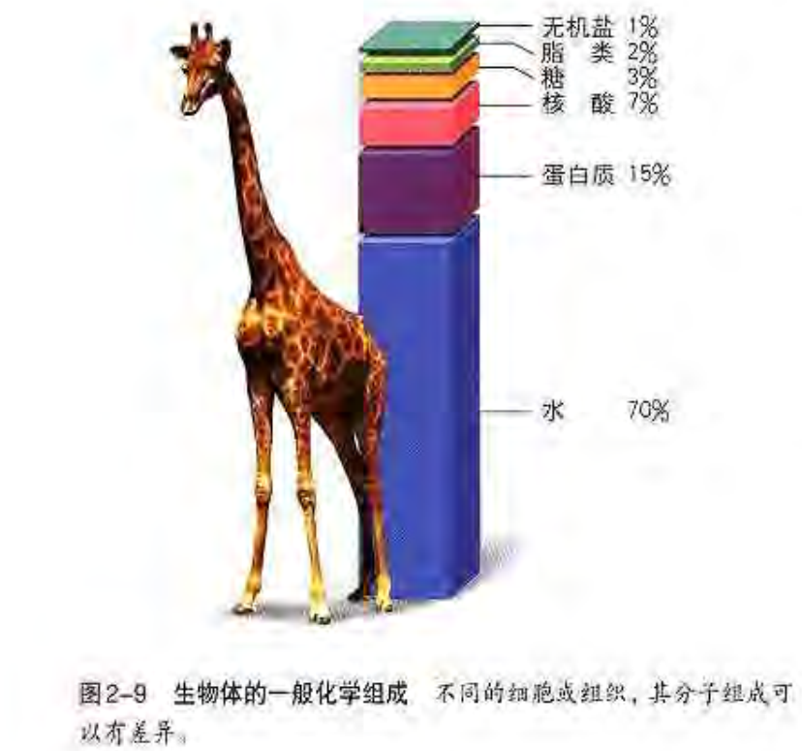
B0. General Introduction

Slide 4
B0. General Introduction
Proteins have widely diverse forms and functions.
enzymes(酶), hormones(激素,荷尔蒙), antibodies(抗体), transporters(转运蛋白),
muscle(肌肉), lens protein of eyes(眼睛晶状体), spider webs(蜘蛛网), rhinoceros horn(犀牛角),
Antibiotics（抗生素）
mushroom poisons(蘑菇毒素).

Slide 5
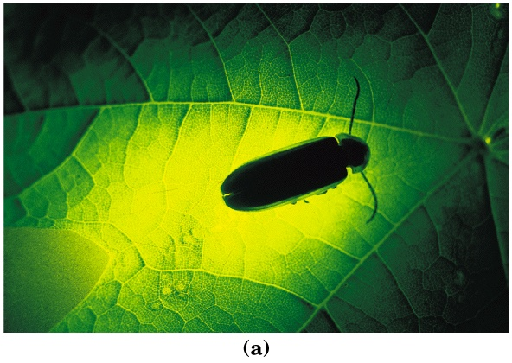
A few examples on protein diversity…
Fireflies emit light catalyzed by luciferase（萤光素酶） with ATP

Slide 6
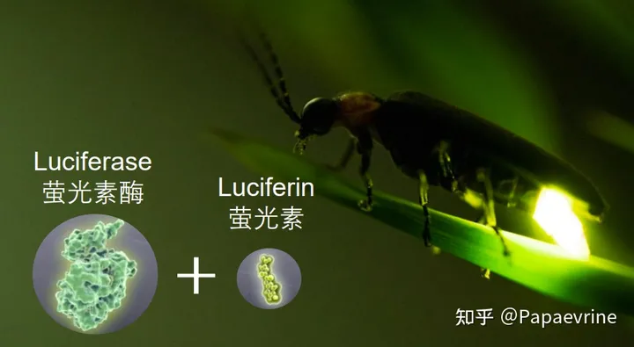
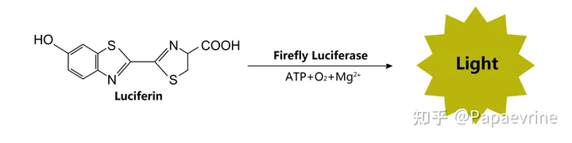

Slide 7
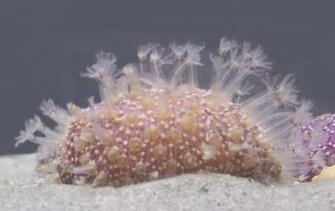
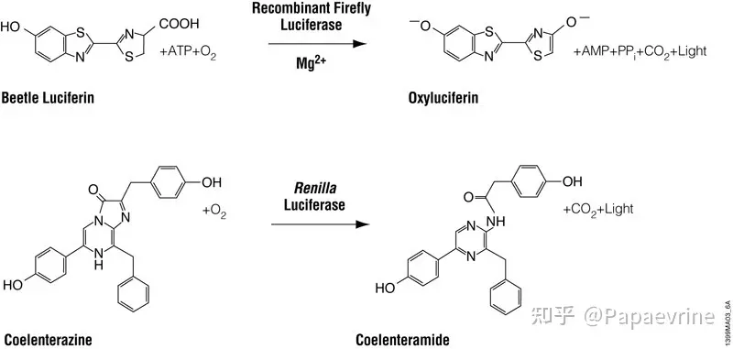

Slide 8
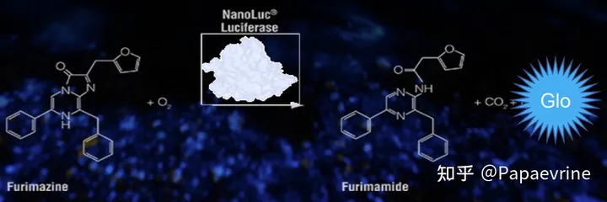
NanoLuc（Nluc）
源自深海细脚刺虾，是一个经过基因工程改造的小分子酶（19.1kDa，171个氨基酸，513bp），是Promega的专利萤光素酶，结构简单，没有翻译后修饰或者二硫键。它使用一种新型底物—Furimazine，不依赖ATP，光信号更亮。

Slide 9
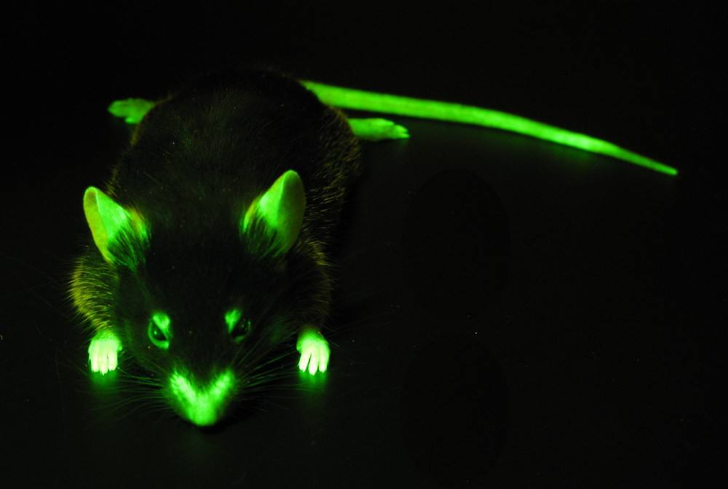
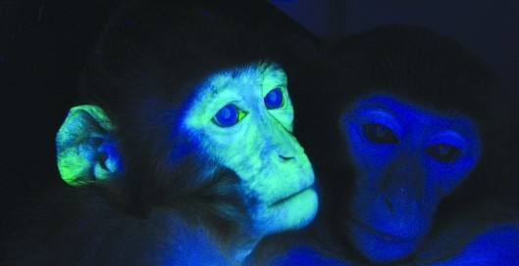
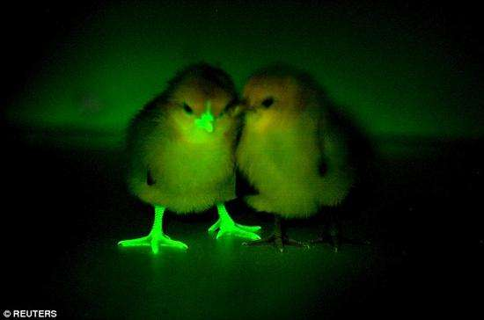
——百度图片

Slide 10
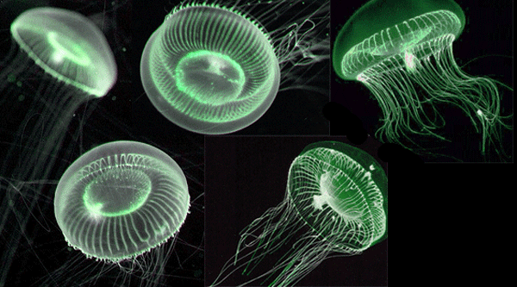
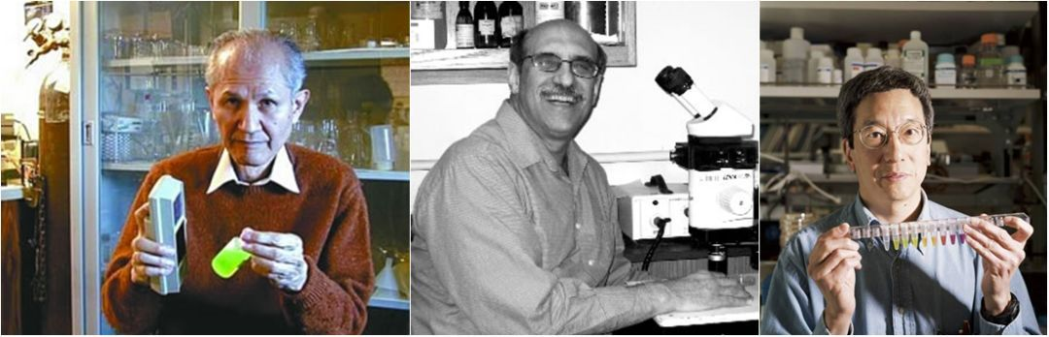
Aequorea
Green fluorescent protein
绿色荧光蛋白
2008年，瑞典皇家科学院将当年诺贝尔化学奖分别授予日本科学家下村修（左一）、美国科学家马丁·查尔菲（中）和美籍华裔科学家钱永健（左三）
钱永健演讲
https://www.bilibili.com/video/BV1f4411k755?is_story_h5=false&p=1&share_from=ugc&share_medium=android&share_plat=android&share_session_id=c4e40565-2c67-4466-8031-7021e3f37bdc&share_source=WEIXIN&share_tag=s_i&timestamp=1662295220&unique_k=2Dio5zi

Slide 11
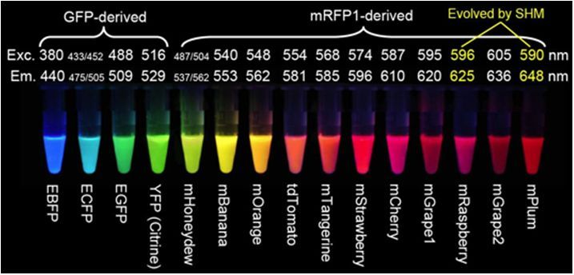
钱永健实验室改造的一系列荧光蛋白变体及其被激发光照射后呈现出的颜色

Slide 12
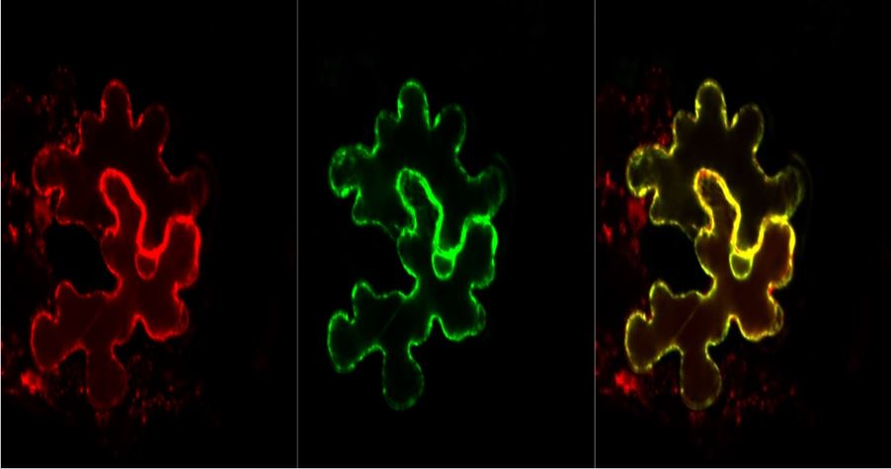
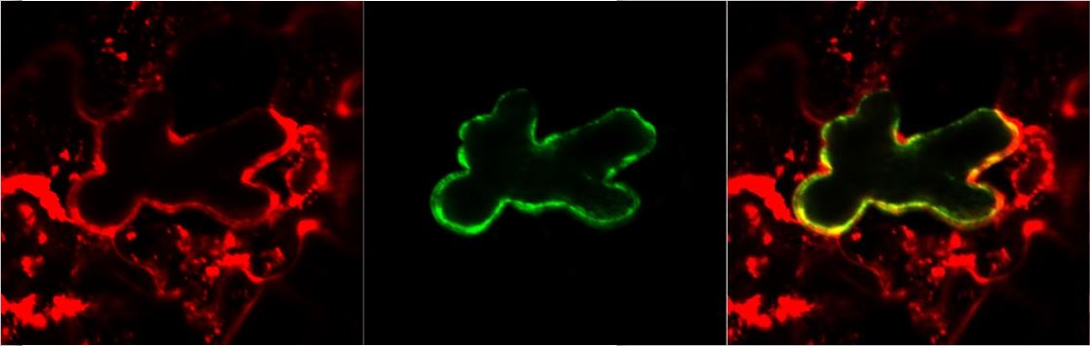
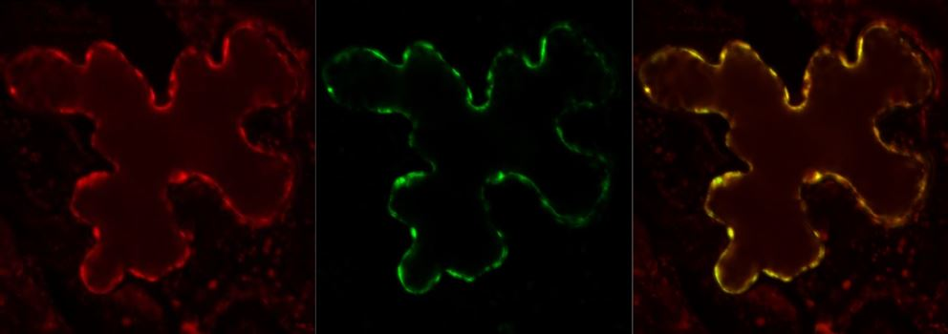
ER Marker:CD3-959
PSL-nGFP
Merge
SR1-cGFP
SR2-cGFP
SR3-cGFP
路俊尧完成

Slide 13
B0. General Introduction
Proteins are polymers(多聚体) of amino acids.
20 amino acids (氨基酸) ➔ millions of proteins with different properties and activities.

Slide 14
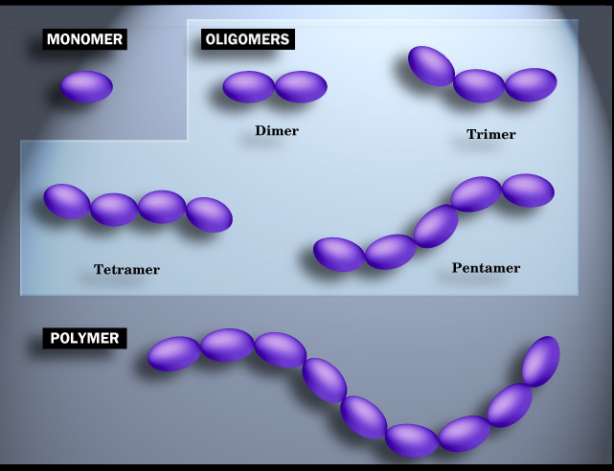

Slide 15
Single (1) (also: singleton, sole, only, etc.)
Double (2) (also: pair, twice)
Triple (3) (also: triplet, treble, thrice, threesome, troika, trio)
Quadruple (4)
Quintuple or Pentuple (5)
Sextuple or Hextuple (6)
Septuple (7)
Octuple (8)
Nonuple (9)
Decuple (10)
Hendecuple or Undecuple (11)
Duodecuple (12)
Centuple (100)
monomer —— 单体；
from Greek mono "one"
and meros "part")
dimer —— 二聚体；
trimer —— 三聚体；
tetramer —— 四聚体；
pentamer —— 五聚体；
hexamer —— 六聚体；
heptamer —— 七聚体；
octamer —— 八聚体；
nonamer —— 九聚体；
decamer —— 十聚体；

Slide 16
Biological Monomers
What to Look For = What’s Important:
Functional Groups: amino, carboxyl, carbonyls (both), alcohol, methyl, phosphate, sulfhydryl, and others.
Ionization state, or not.
Solubility
Covalent Bonds – single, double, triple.
Weak Bonds = H-bonds, Ionic bonds, hydrophobic interactions, van der Waals forces.
How Monomers are Polymerized
Notes:
16

Slide 17
Proteins are polymers(多聚体) of amino acids.
20 amino acids (氨基酸) ➔ millions of proteins with different properties and activities.
Protein structures are studied at primary,
secondary,
tertiary
and quaternary levels.
高级构象

Slide 18
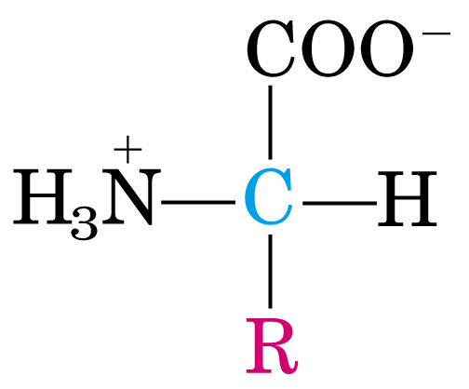
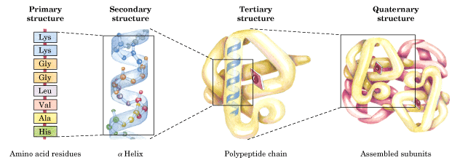
amino acid

Slide 19
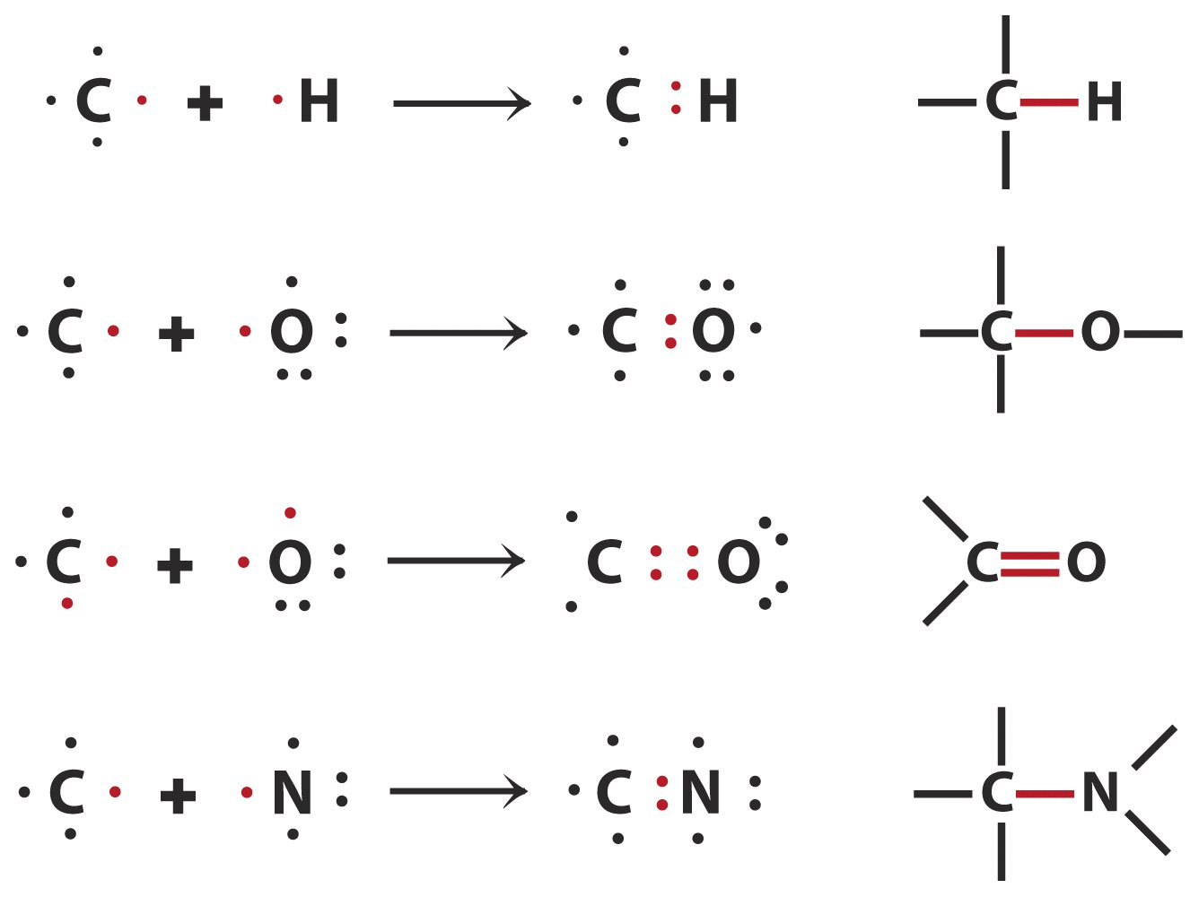
Carbon Bonding
Notes:
19

Slide 20
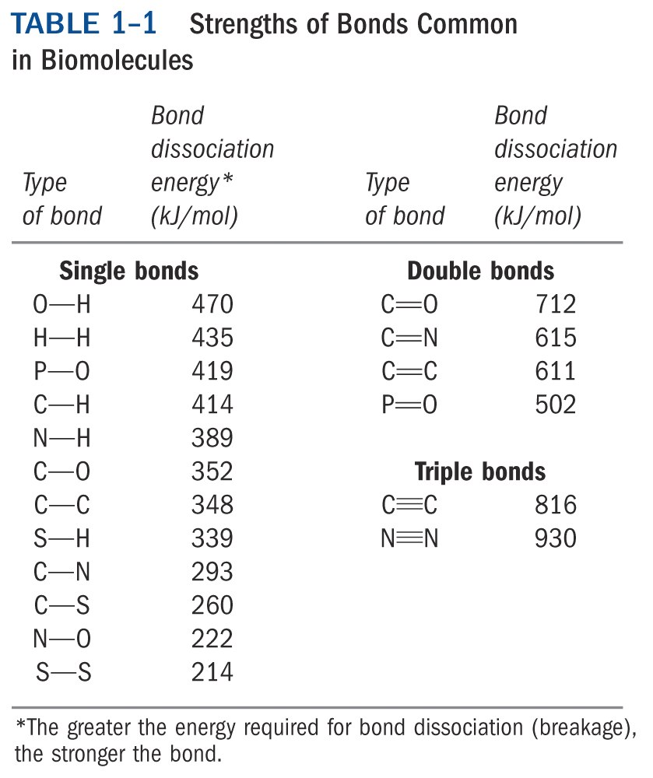
Notes:
20

Slide 21
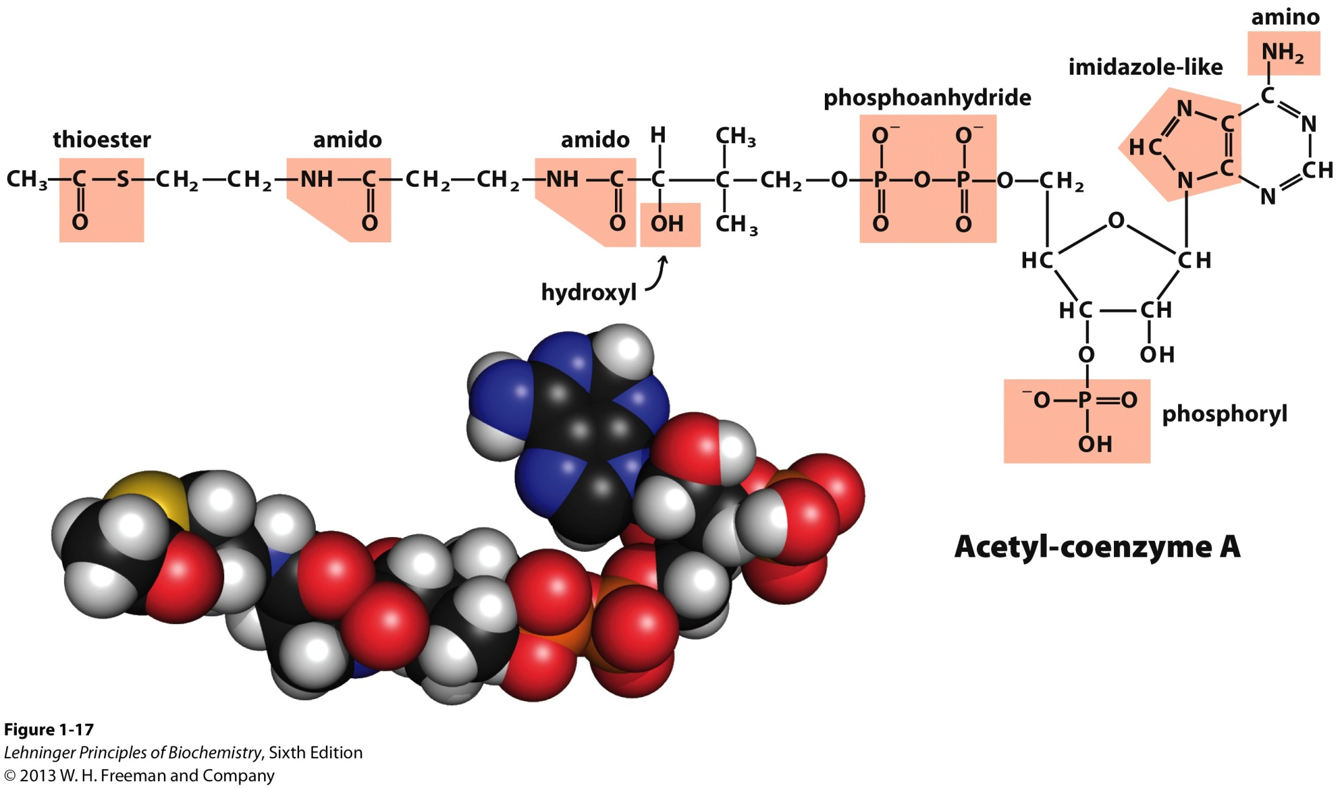
Biological molecules typically have several functional groups
Notes:
21

Slide 22
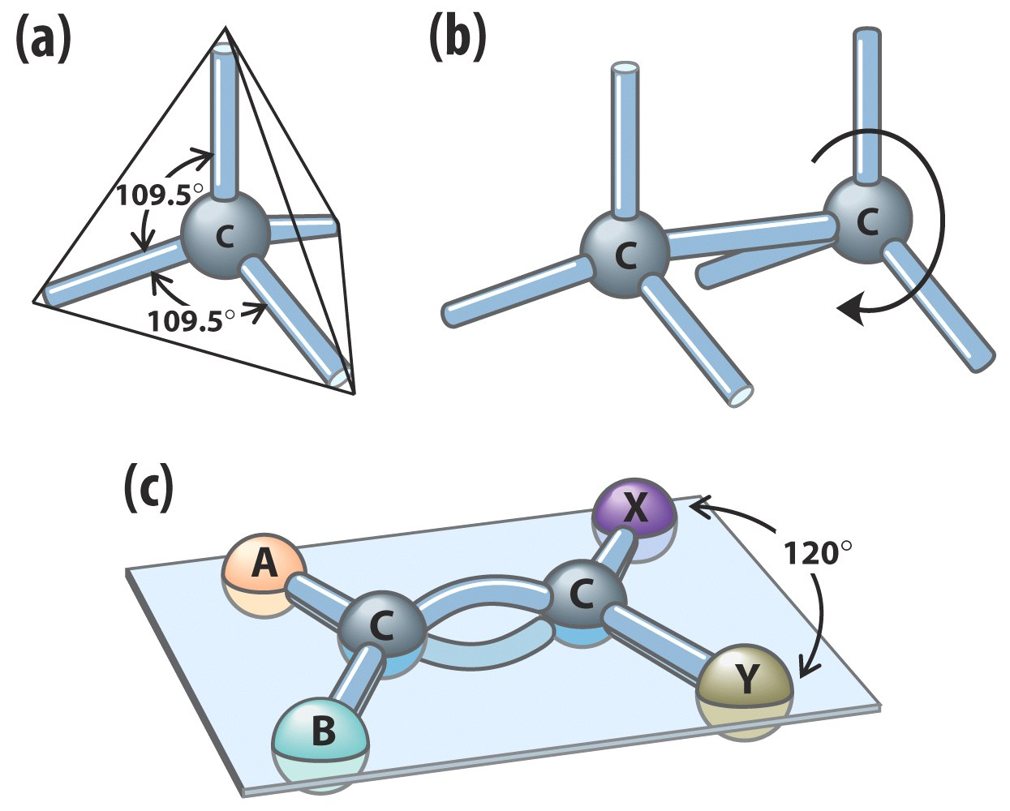
Bond Angles and Rotation
Notes:
22

Slide 23
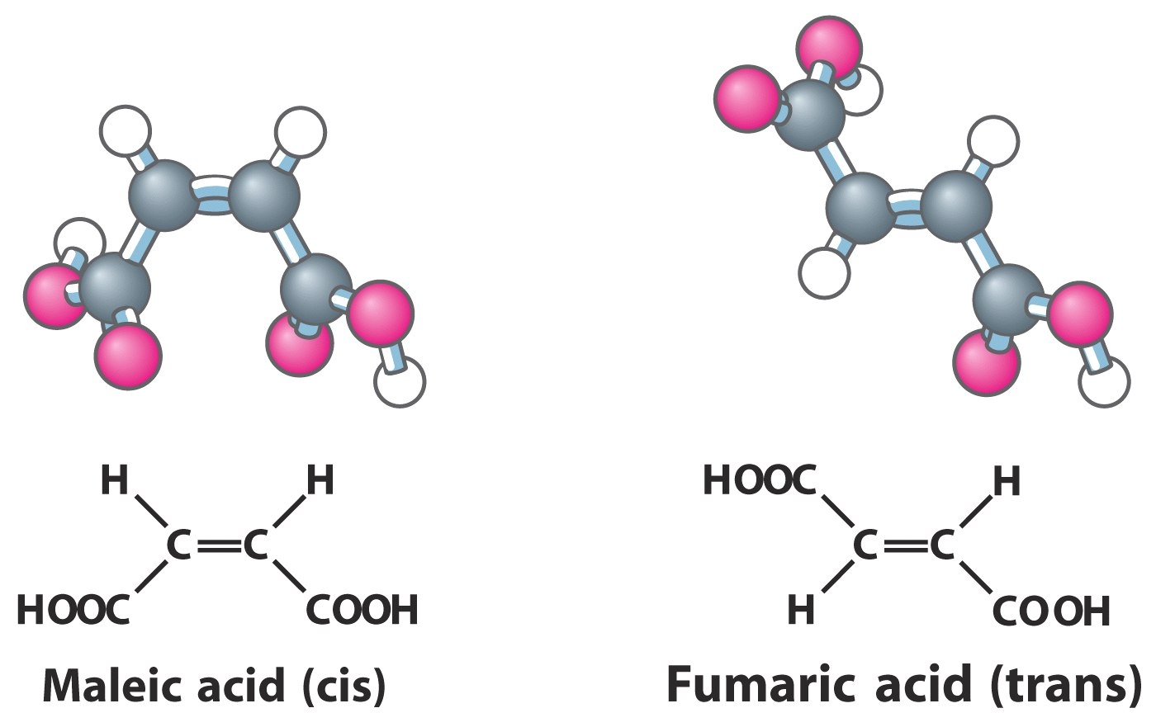
Cis and Trans
Notes:
23

Slide 24
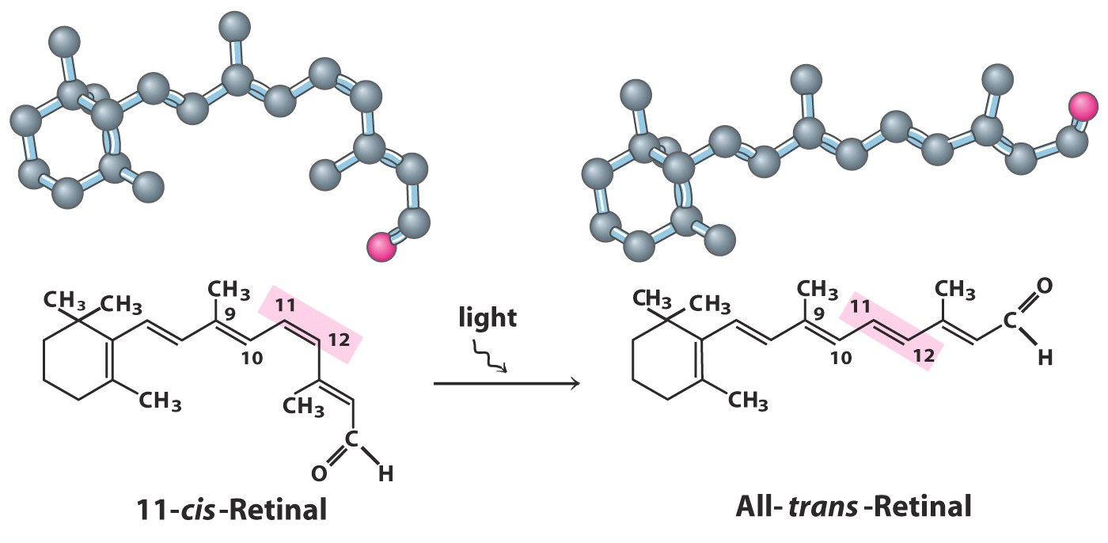
Cis and Trans –Change
Notes:
24

Slide 25
Summary of B0
Proteins are polymers of 20 amino acids;
Protein structures are studied at primary, secondary, tertiary and quaternary levels.
Biomolecules are compounds of carbon with a variety of functional groups.

Slide 26
Section B1 Amino acid structure
1. All natural proteins were found to be built from the same set of 20 standard α-amino acids.
2. The 20 amino acids are usually grouped according to the properties (mainly polarity) of their R groups.
3. Nonstandard amino acids are found in certain proteins, generally as a result of post-translational modifications.
4. The amino acids ionize in aqueous solutions.

Slide 27
1. All natural proteins were found to be built from the same set of 20 standard α-amino acids
The earliest studies of proteins focused on the free amino acids derived from these proteins.
  The 1st amino acid (asparagine) was discovered in 1806 from asparagus (a green vegetable).
  The last (threonine) was not identified until 1938!
  Glutamate from wheat gluten (sticky). Tyrosine from cheese .

Slide 28
The names of the amino acids are often abbreviated, either to three letters or to a single letter.
Glycine (Gly, G) 甘氨酸
Alanine (Ala, A) 丙氨酸
Valine (Val, V) 缬氨酸
Leucine (Leu, L) 亮氨酸
Isoleucine (Ile, I) 异亮氨酸
Methionine(Met, M) 蛋氨酸
Proline (Pro, P) 脯氨酸
Hydrophobic, aliphatic amino acids

Slide 29
Polar, uncharged amino acid
Serine (Ser, S) 丝氨酸
Threonine (Thr, T) 苏氨酸
Cysteine (Cys, C) 半胱氨酸
Asparagine (Asn, N) 天冬酰胺
Glutamine (Gln, Q) 谷氨酰氨

Slide 30
Hydrophobic, aromatic amino acids
Phenylalanine (Phe,F) 苯丙氨酸
Tyrosine (Tyr,Y) 酪氨酸
Tryptophan (Trp, W) 色氨酸

Slide 31
Polar, charged amino acid
Arginine (Arg, R) 精氨酸
Lysine (Lys, K) 赖氨酸
Histidine (His, H) 组氨酸
Aspartate (Asp, D) 天冬氨酸
Glutamate (Glu, E) 谷氨酸

Slide 32
1.1 The 20 α-amino acids share
common structural features.
  Each has a carboxyl group and an amino group (but one has an imino group in proline) bonded to the same carbon atom, designated as the α-carbon.

Slide 33
  Each has a different side chain (or R group, R=“Remainder of the molecule”).
1
2
α
β

Slide 34
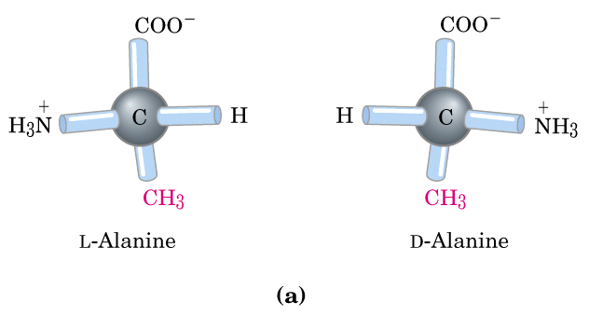
The α-carbons for 19 of them are asymmetric (or chiral), thus being able to have two stereoisomers. Glycine has no chirality.
α
α

Slide 35
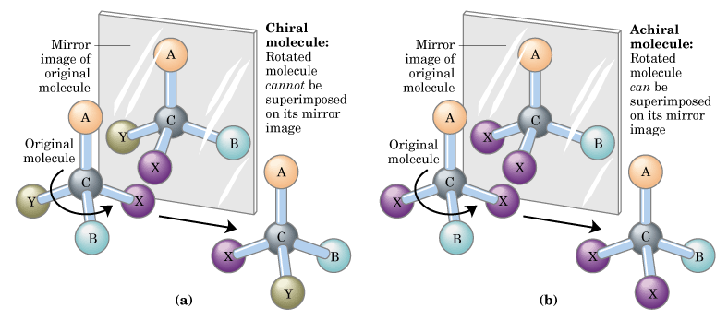
Enantiomers (The Cα atom is an asymmetric center or chiral center)

Slide 36
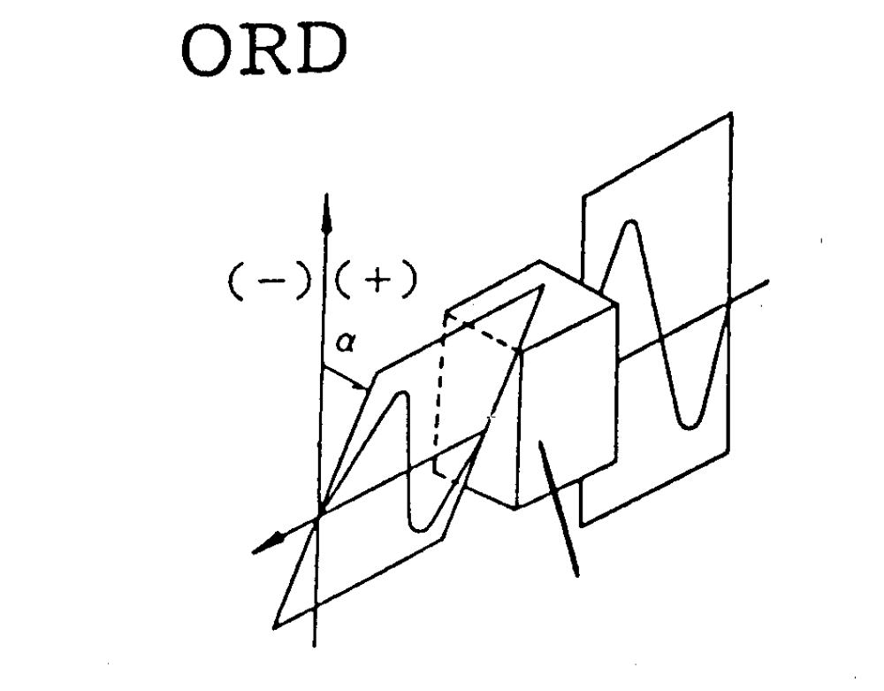
某些光学活性介质能使平面偏振光的偏
振面发生旋转
旋光性（optical rotation）
光学活性（optical activity）
“手性” (chiral)
入射光的偏振面
出射光的偏振面
光学活性介质

Slide 37
About AA stereoisomers：
  The correlation of structure (or configuration) with optical rotation is very complex and has not been successful to date! (i.e., the D- and L-signs do not tell anything about their optical rotation!)
  Only the L-amino acids have been found in proteins (D-isomers have been found only in small peptides of bacteria cell walls and in some peptide antibiotics).
  L-α-AA

Slide 38
1.2 Each amino acid is given a three-letter abbreviation and a one-letter symbol. They often use the first three letter and the first letter. When there is confusion, an alternative is used. These must be remembered.

Slide 39
Glycine (Gly, G)
Alanine (Ala, A)
Valine (Val, V)
Leucine (Leu, L)
Isoleucine (Ile, I)
Methionine(Met, M)
Proline (Pro, P) （total 7 AAs）
Serine (Ser, S)
Threonine (Thr, T)
Cysteine (Cys, C)
Asparagine (Asn, N)
Glutamine (Gln, Q)
（Total 5 AAs）
Phenylalanine (Phe,F)
Tyrosine (Tyr,Y)
Tryptophan (Trp, W)
(total 3 AAs)
Arginine (Arg, R)
Lysine (Lys, K)
Histidine (His, H)
Aspartate (Asp, D)
Glutamate (Glu, E)
(total 5 AAs)

Slide 40
1.3 All proteins in all species (from bacteria to human) are constructed from the same set of 20 amino acids.
  All proteins, no matter how different they are in structure and function, are made from the same set of 20 standard amino acids.
  This fundamental alphabet of the protein language is at least two billion years old.

Slide 41
2. The 20 amino acids are usually grouped according to the properties (mainly polarity) of their R groups
2.1 seven amino acids have nonpolar, aliphatic
(hydrophobic) R groups.
    They are Gly, Ala, Val, Leu, Ile, Met and Pro.
    Gly has a hydrogen as its R group, having minimal steric hindrance.
    In protein structure Gly offers the most flexibility!
    Ala, Val, Leu, Ile and Met have hydrocarbon R groups, often involved in hydrophobic interactions.

Slide 42
    Pro has an imino group, instead of an amino group, forming a five-membered ring structure, being rigid in conformation.
    Pro is often found in the bends of folded protein chains and often present on the surface of proteins. It offers the least flexibility.

Slide 43
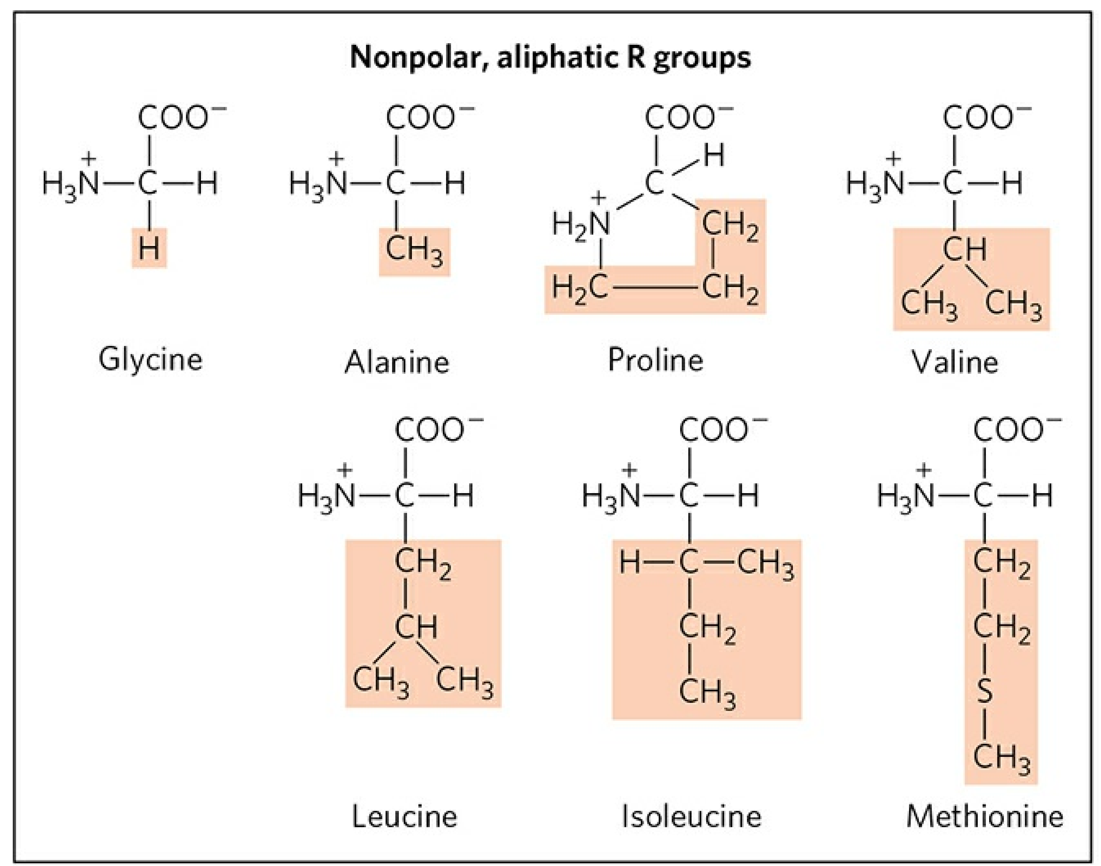
Gly, G, 甘氨酸
Ala, A, 丙氨酸
Val, V, 缬氨酸
Leu, L, 亮氨酸
Ile, I, 异亮氨酸
Met, M, 蛋氨酸,
甲硫氨酸
Pro, P, 脯氨酸

Slide 44
2.2 Ser, Thr, Asn, Gln, and Cys have polar, uncharged R groups.
  The R groups are more hydrophilic, due to the presence of hydroxyl groups, sulfur atoms, or amide groups.
  -SH group (sulfhydryl) of two Cys in proteins can be oxidized to form a covalent disulfide bond.
  Cys often participates in hydrophobic interactions.

Slide 45
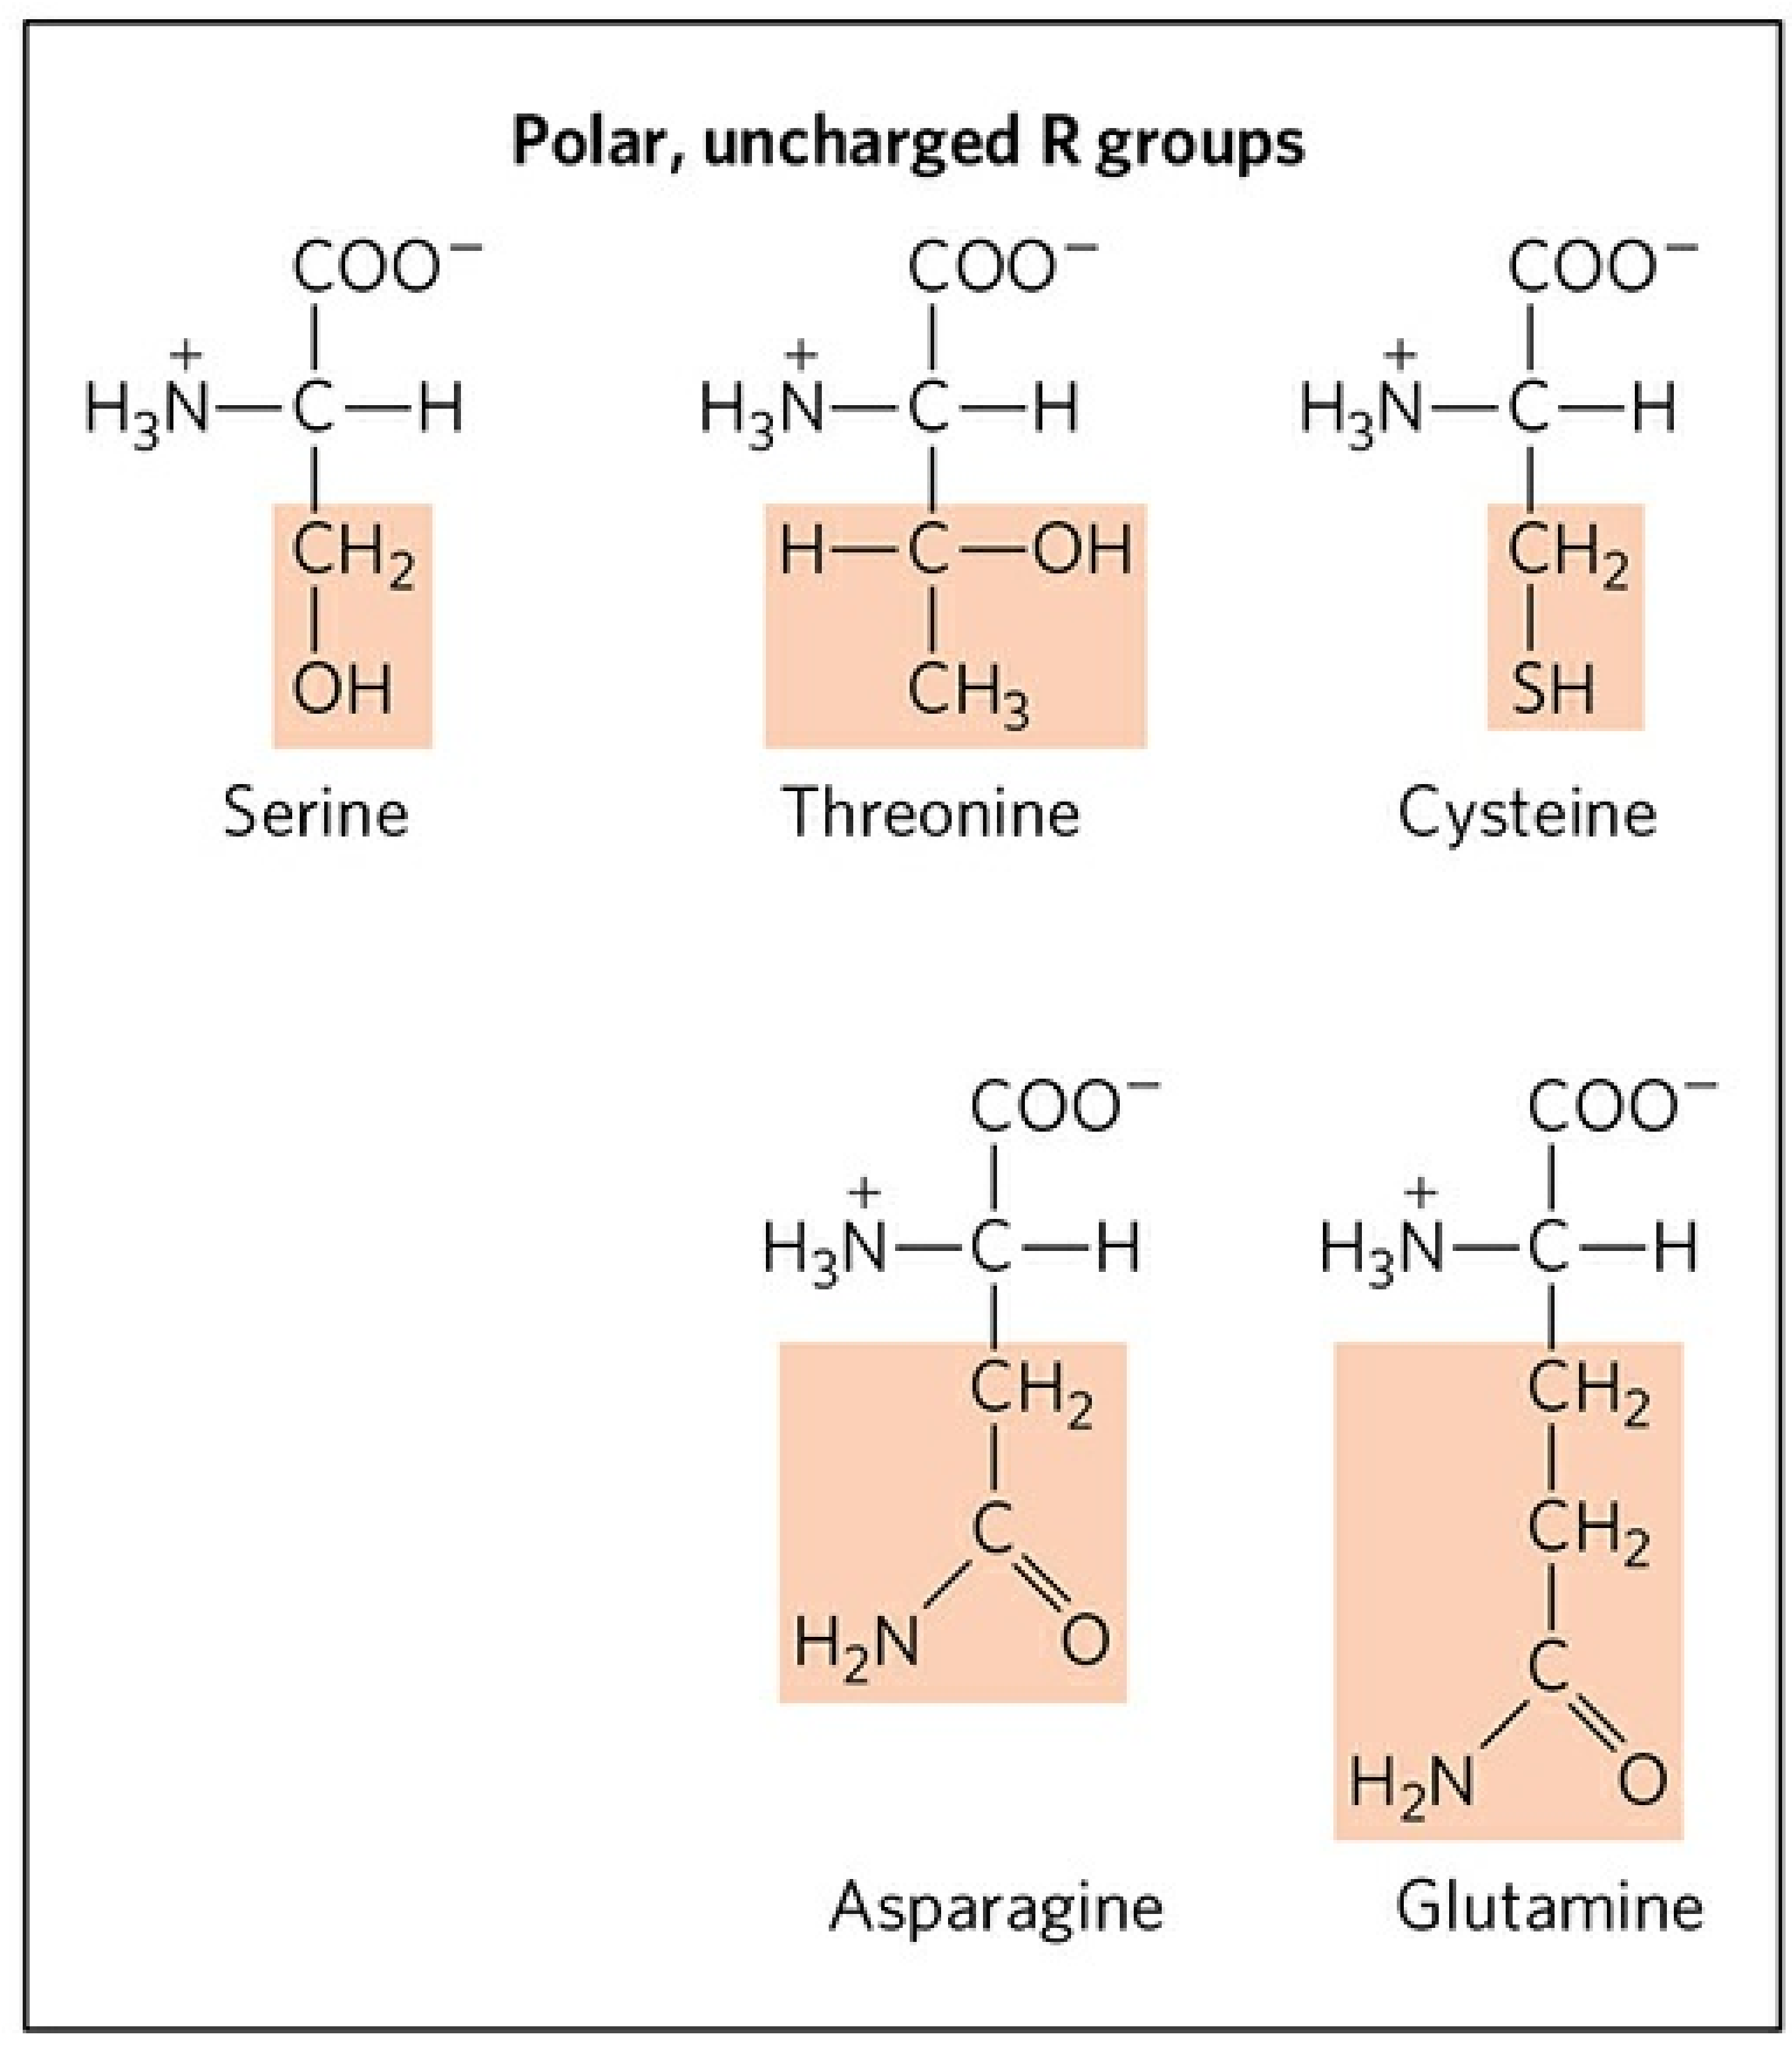
Ser, S, 丝氨酸
Thr, T, 苏氨酸
Cys, C, 半胱氨酸
Asn, N, 天冬酰胺
Gln, Q, 谷氨酰胺

Slide 46
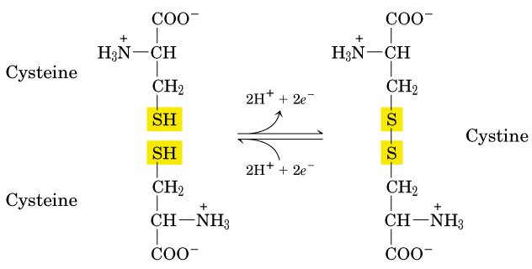
Cystine (胱氨酸) is a dimer of cysteine (半胱氨酸)

Slide 47
2.3 Phe, Tyr, and Trp have aromatic (芳香族)
R groups
  Phe and Tyr both have benzene rings.
  Tryptophan has an indole ring（吲哚）.
  All three participate in hydrophobic interactions.
  The -OH group in Tyr is an important functional group in proteins. (phosphorylation, hydrogen bond, etc)
  They are jointly responsible for the light absorption of proteins at 280 nm, a property used as a measure of the concentration of proteins.

Slide 48
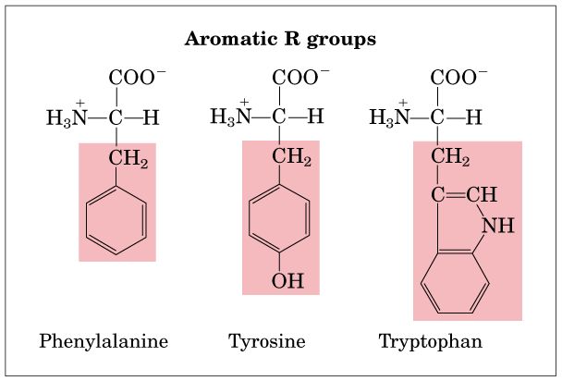
Phe, F, 苯丙氨酸; Tyr, Y, 酪氨酸; Trp, W, 色氨酸
indole ring
benzene ring

Slide 49
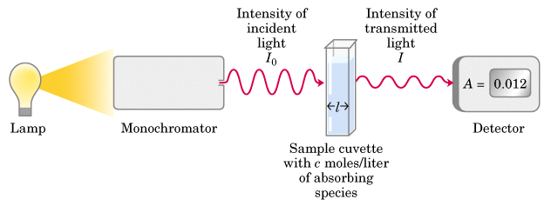
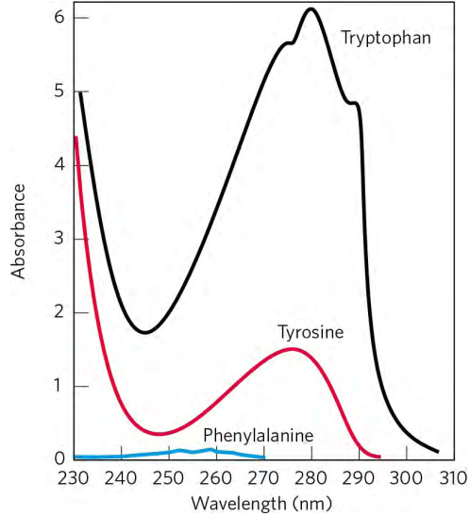
Lambert-Beer’s law:
A=Log I_{o}/I = εcl
ε, extinction coefficient;
c, concentration;
l, optical length

Slide 50
2.4 Positively charged (basic) and negatively
charged (acidic) R groups
  The most hydrophilic R groups are those either positively or negatively charged.
  Asp and Glu have carboxyl in their R groups. They have net negative charge at pH 7.0, thus usually named as aspartate and glutamate (conjugate base names, instead of aspartic acid and glutamic acid, un-ionized form).

Slide 51
  Arg, Lys, and His have positively charged R groups at pH 7.0.
    Their R groups contain guanidino(胍基), amino, imidazole(咪唑基) groups respectively.
    The side chain of His can be positively or uncharged depending on the local environment near pH 7.0

Slide 52
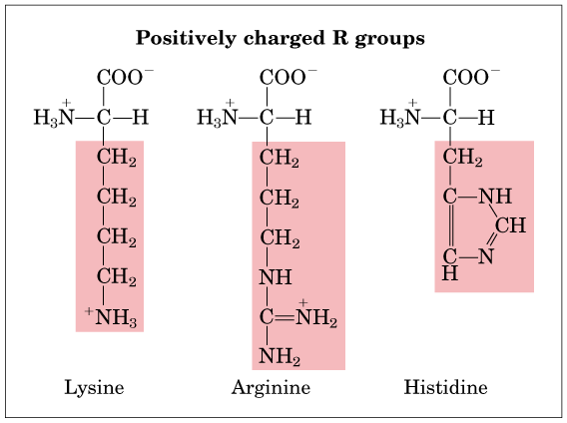
Lys, K, 赖氨酸; Arg, R, 精氨酸; His, H, 组氨酸
guanidino(胍基)
imidazole(咪唑基)

Slide 53
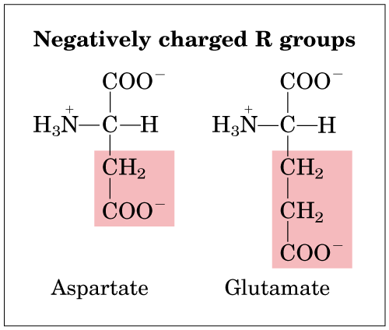
Asp, D,天冬氨酸; Glu, E,谷氨酸

Slide 54
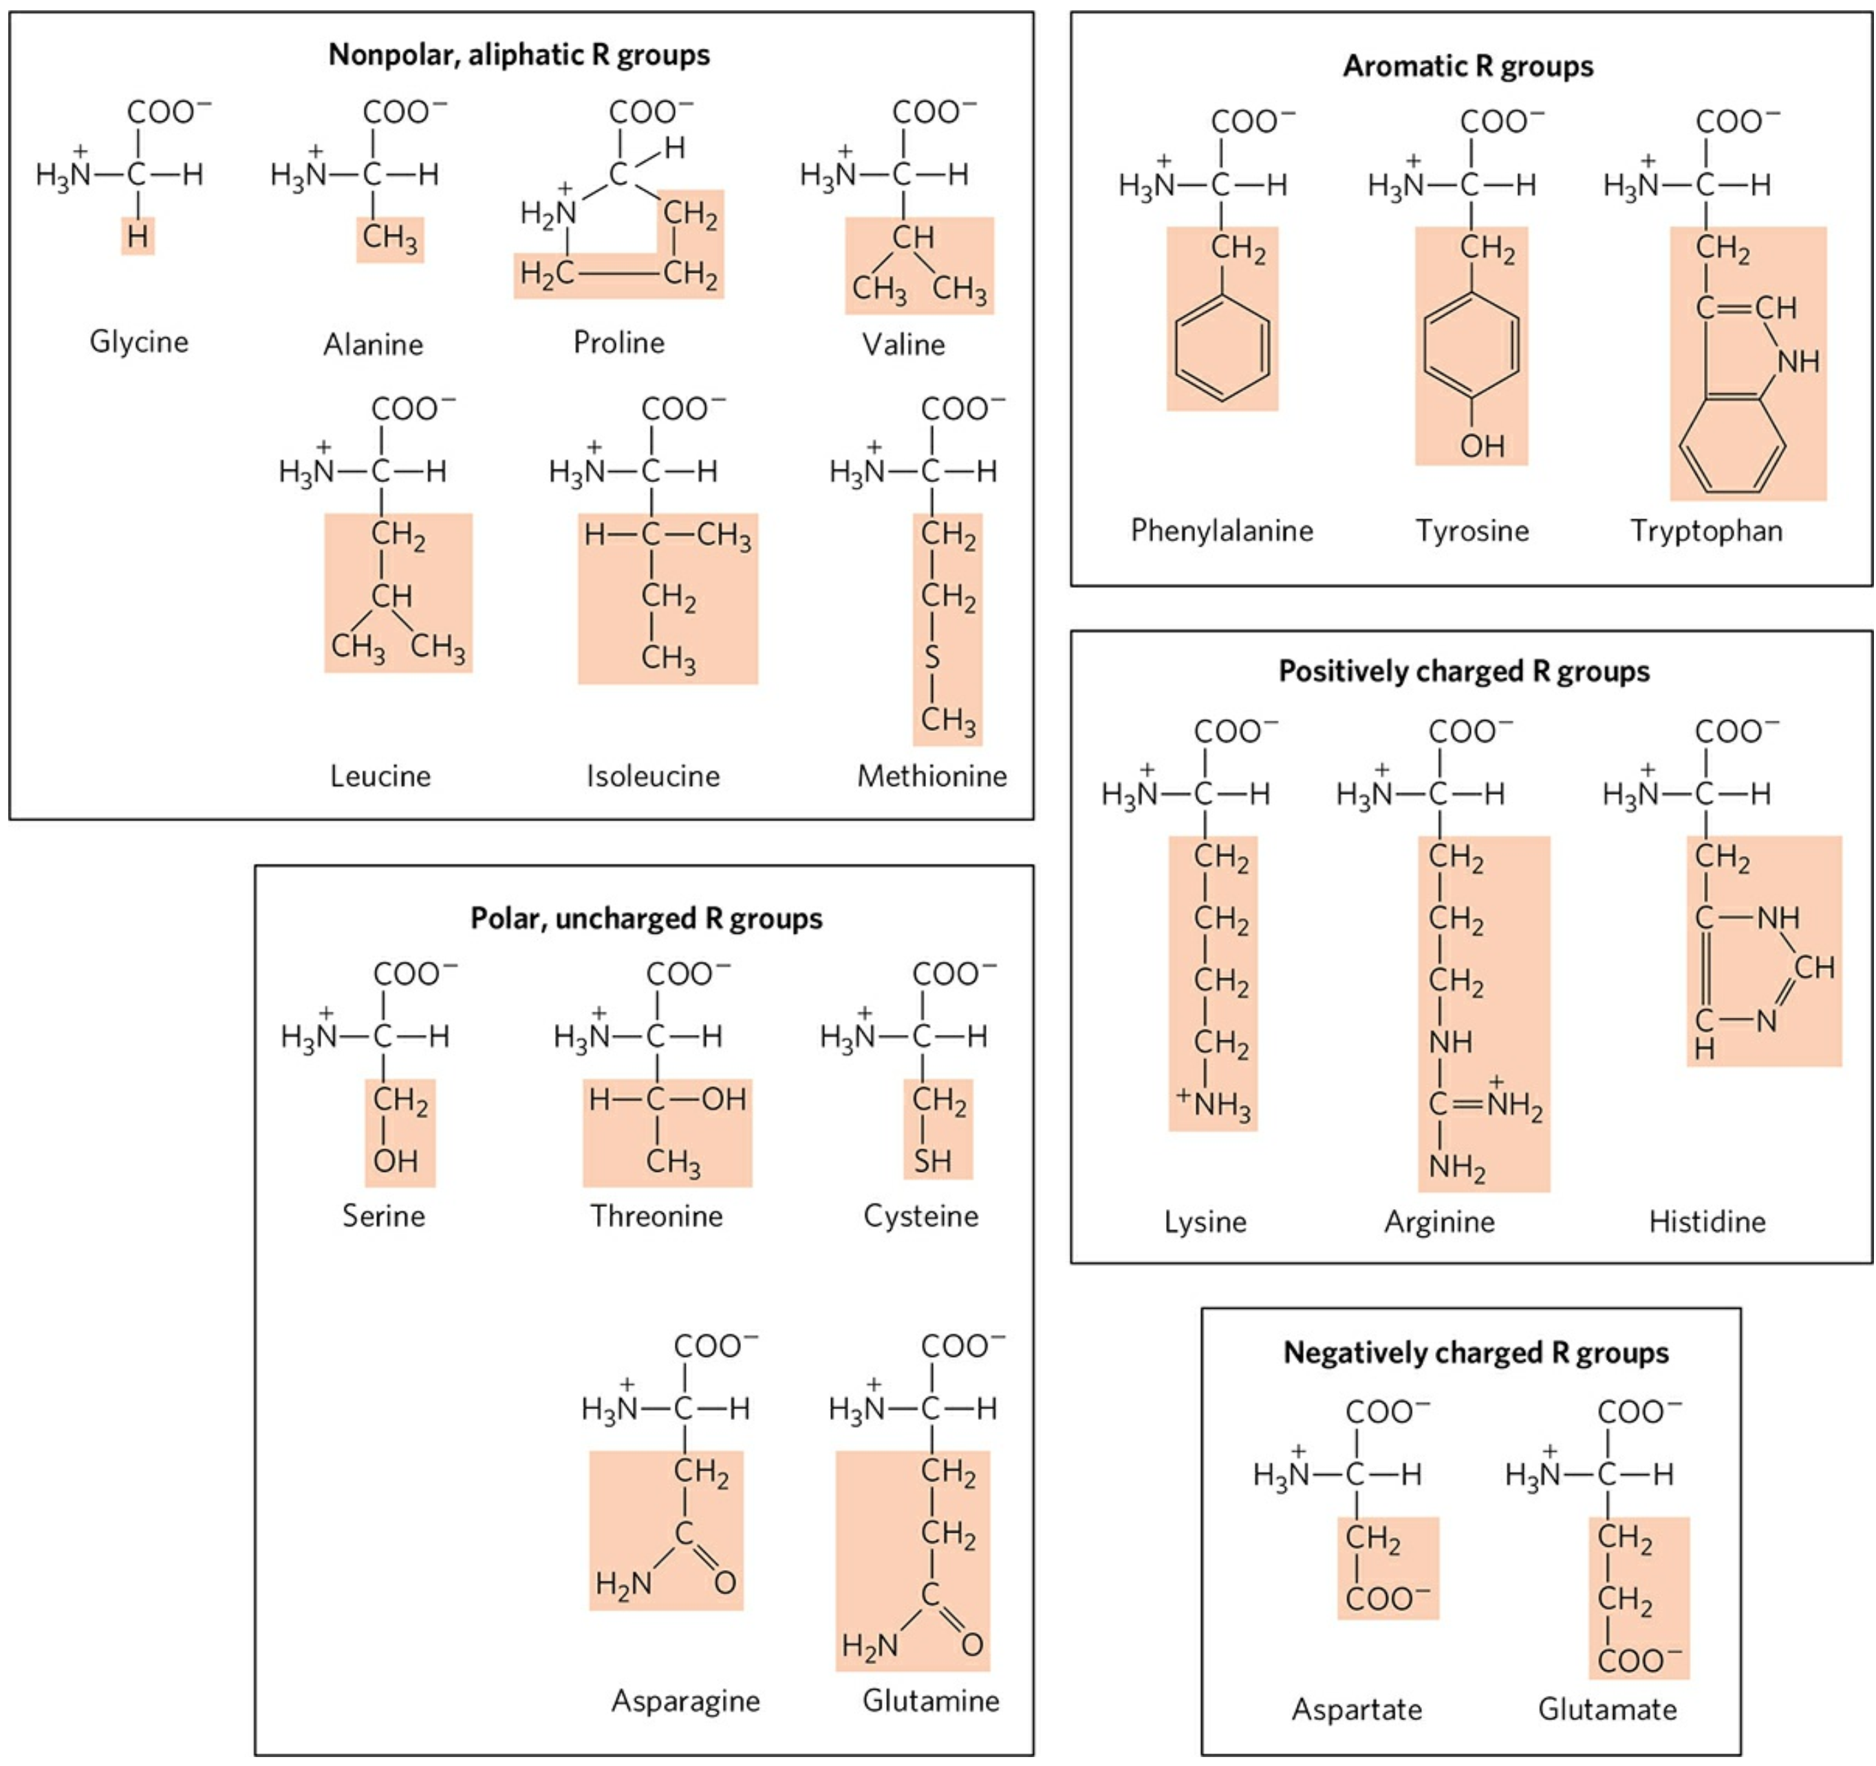
  benzene rings.
  indole ring（吲哚）
guanidino(胍基)
imidazole(咪唑基)
next

Slide 55
3. Nonstandard amino acids are found in certain proteins, generally as a result of post-translational modifications.
  4-Hydroxyglutamate and 5-hydroxylysine in collagen(胶原).
  γ-carboxyglutamate is found in the blood-clotting prothrombin (凝血酶原,an enzyme).
  Many additional nonstandard amino acids are found in cells, but not in proteins (e.g., ornithine鸟氨酸and citrulline瓜氨酸, intermediates in amino acid metabolism).

Slide 56
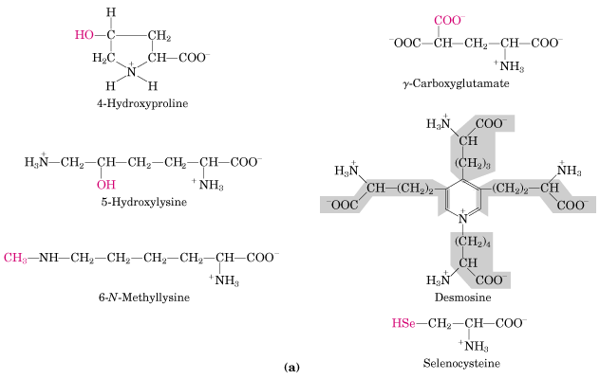

Slide 57
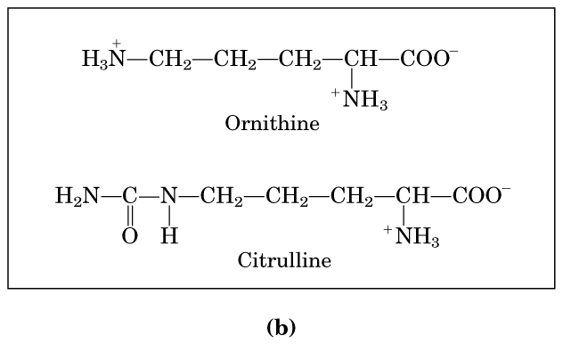


Slide 58
Two additional amino acids have been identified
Selenocysteine(硒代半胱氨酸): encoded by the RNA nucleotide triplet UGA found in Archaea, eubacteria and animals including mammals.
Pyrrolysine (吡咯赖氨酸): encoded by the RNA nucleotide triplet UAG, found in Archaea, and eubacteria.
Science (2002) vol. 296, 1409
Nature may yet surprise us with more directly encoded amino acids.

Slide 59
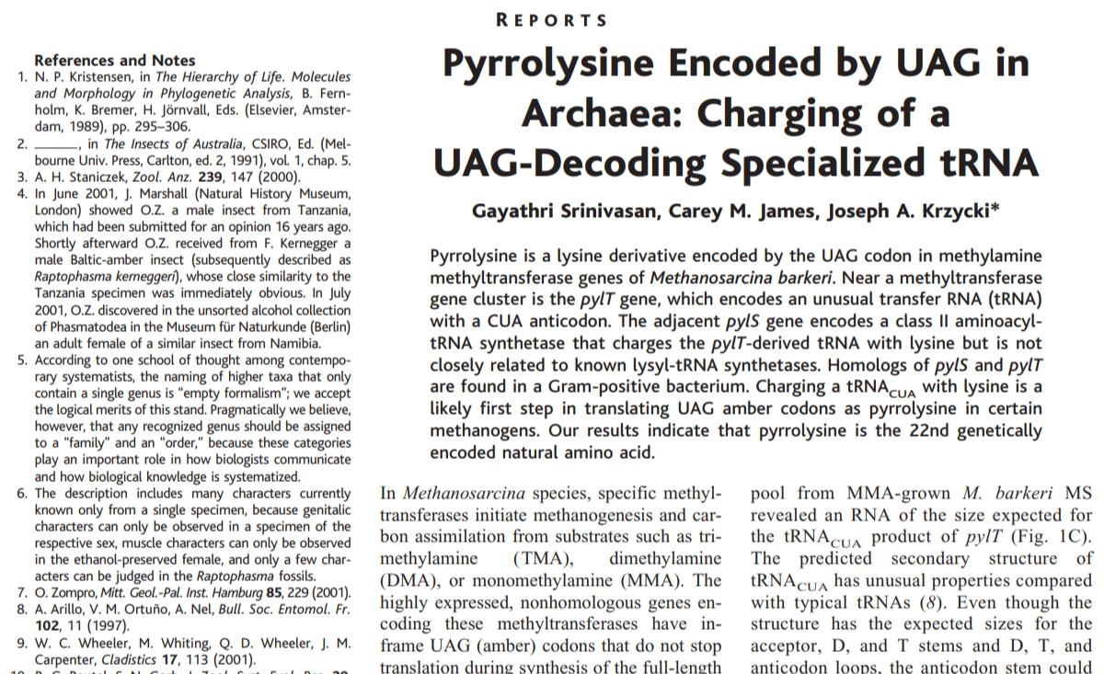
DOI: 10.1126/science.1069588

Slide 60
Summary of B1 Amino acid structure
1. All natural proteins were found to be built from the same set of 20 standard L-α-amino acids.
2. The 20 amino acids are usually grouped according to the properties (mainly polarity) of their R groups.
How many groups? And what they are?
3. Nonstandard amino acids are found in certain proteins, generally as a result of post-translational modifications.

Slide 61
Summary of B1
Standard amino acid /Nonstandard amino acid
L- α-amino acids
nonpolar, aliphatic amino acid
polar, uncharged amino acid
Aromatic amino acid
Positively charged (basic)
and negatively charged (acidic) amino acid
Essential amino acid
Nonessential amino acid

Slide 62
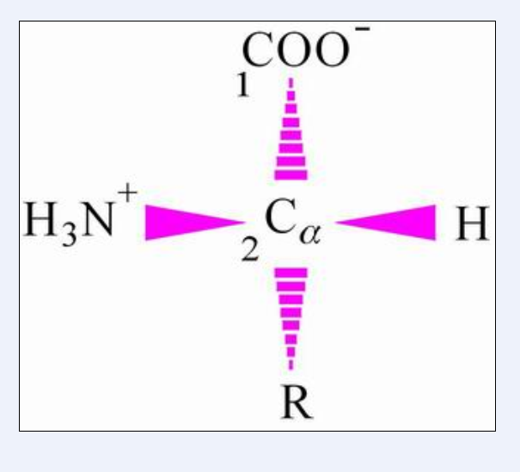

Slide 63
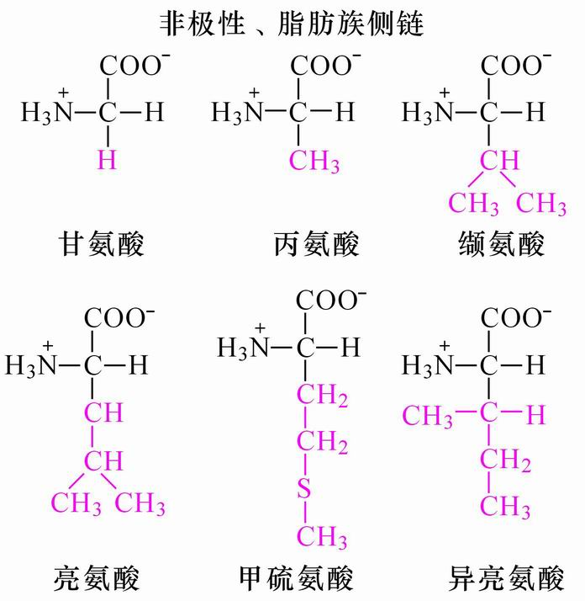
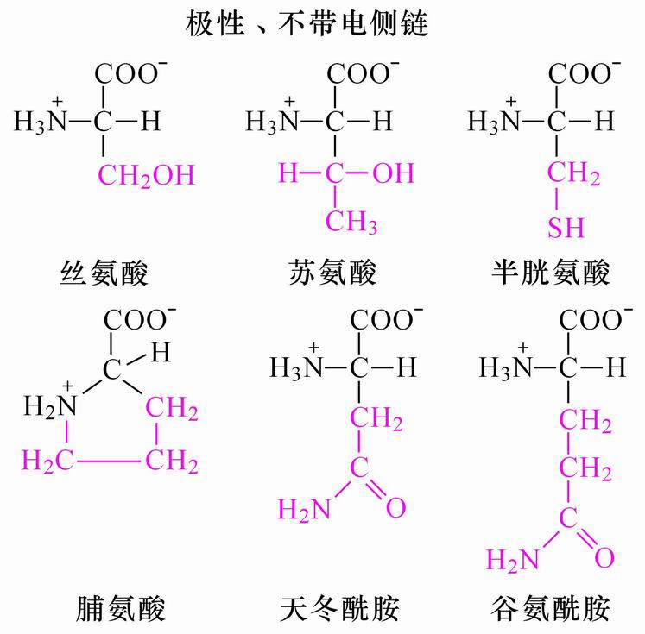
蛋氨酸

Slide 64
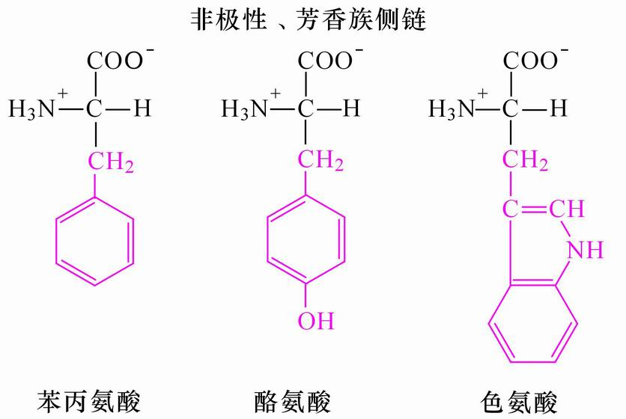

Slide 66
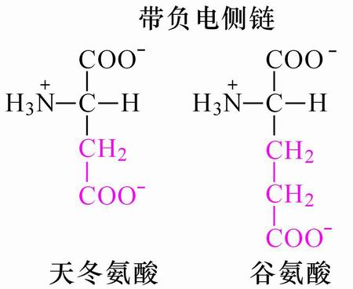

Slide 67
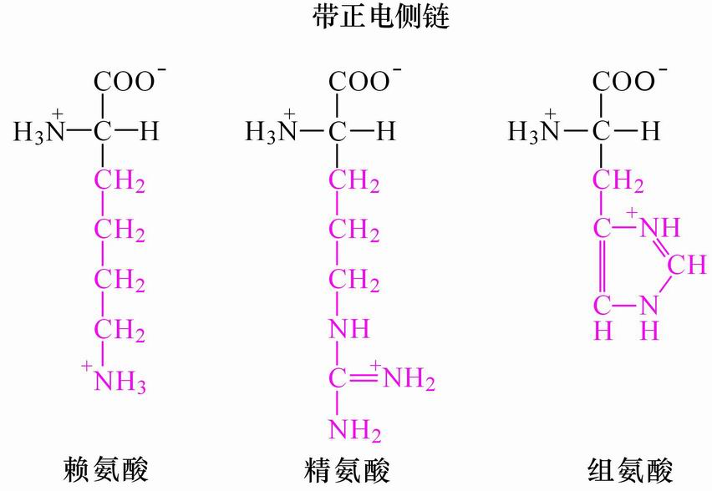

Slide 68
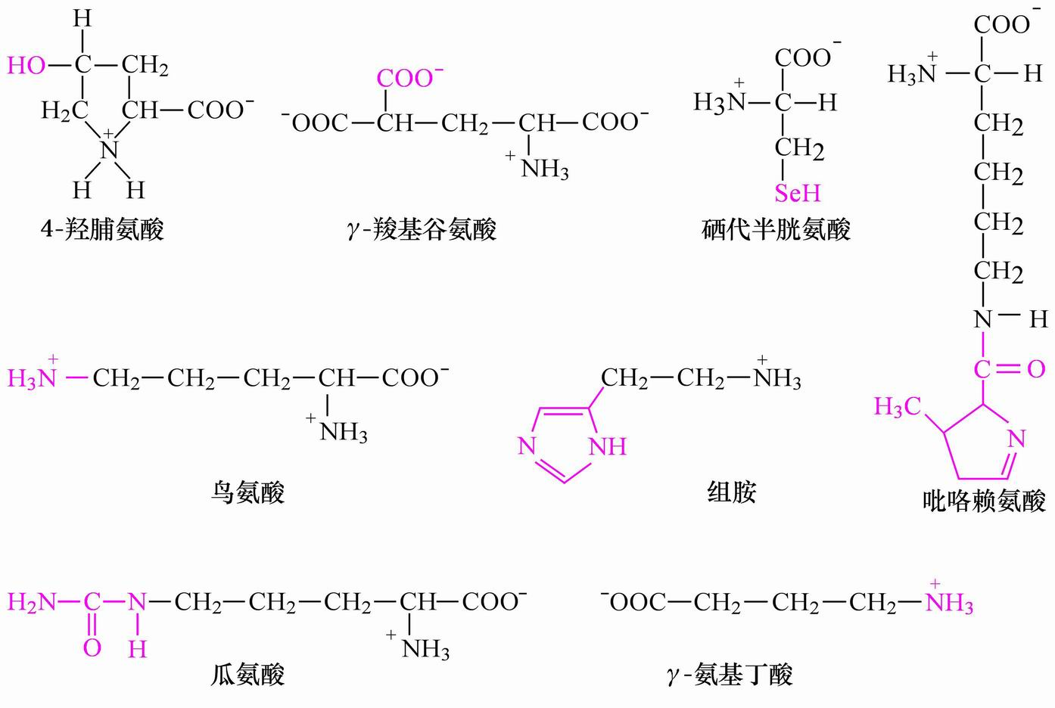

Slide 69
氨基酸的其他分类方法
2C 甘
3C 丙 丝 半 色 酪 苯 组
4C 天 天 苏
5C 谷 谷 脯 缬 蛋
6C 亮 异 赖 精

Slide 70
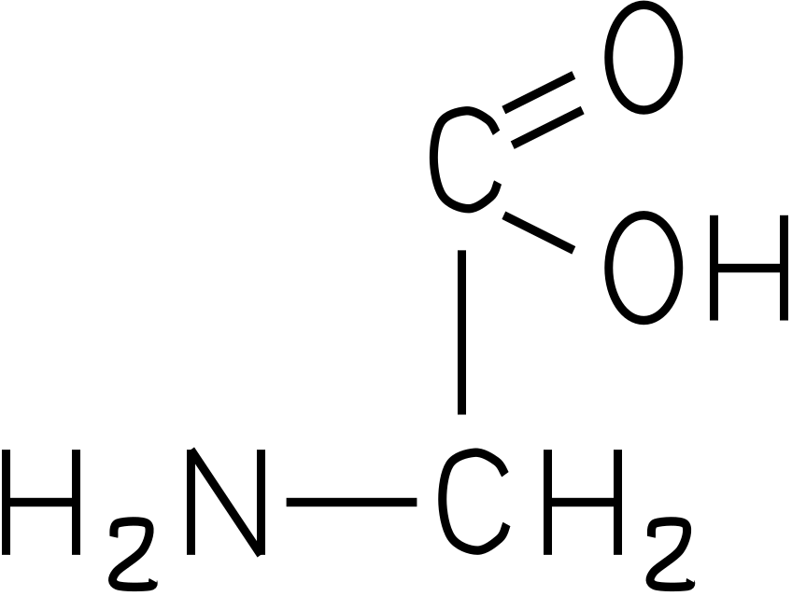
2C

Slide 71
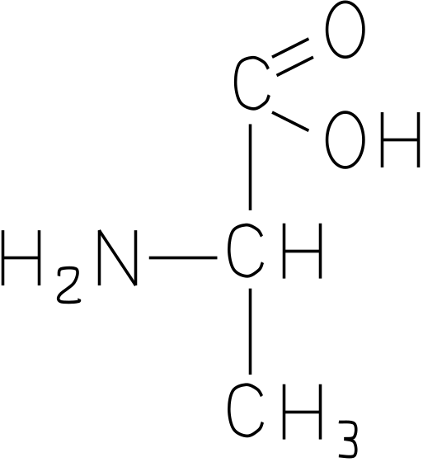
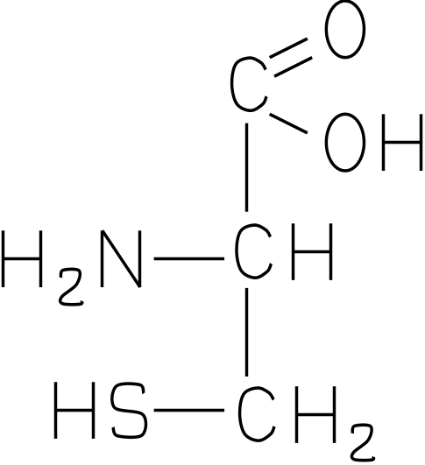

3C

Slide 72


3C

Slide 73


3C

Slide 74



4C

Slide 75


5C

Slide 76



5C

Slide 77


6C

Slide 78


6C

Slide 79
B2 Acids and Bases
Acids, bases and pH
Buffers
Ionization of amino acids

Slide 80

  benzene rings.
  indole ring（吲哚）
guanidino(胍基)
imidazole(咪唑基)

Slide 81

1 Weak acids (proton donors) and weak bases (proton acceptors) do not ionize completely when dissolved in water.
1.1 strong acids (e.g., hydrochloric acids, sulfuric and nitric acids) and strong bases (e.g., NaOH and KOH) ionizes completely when dissolved in water.
1.2 A proton donor and its corresponding proton acceptor make up a conjugate acid-base pair.
双牛曳犁(汉画像石) 河南南阳

Slide 82
1.3 The characteristic tendency of each weak acid for losing its proton is reflected by its dissociation constant Ka (stronger acids have larger Ka value).
1.4 For convenience, Ka is converted to pKa (the negative logarithm).

Slide 83


Slide 84

Henderson-Hasselbalch equation

Slide 85


盐酸滴定曲线

Slide 86


Slide 87


Slide 88
2 The titration curves of weak acids can be fitted by the Henderson-Hasselbach equation
2.1 The amount of weak acids in a solution can be determined by titrating with a strong base of known concentration .
2.2 Titration curves are made from plotting the pH of the solution against the amount of strong base added to neutralize the weak acid (until [proton donor]~0, [proton acceptor]=initial weak acid concentration, that is, all weak acid molecules are ionized, no more buffering effect, pH increases rapidly).

Slide 89
2.3 Titration curves of weak acids have nearly identical shapes (reflecting the same law behind the phenomenon)
2.4 The Henderson-Hasselbalch equation fits the titration curves of all weak acids!
pH = pKa + log[proton acceptor]/[proton donor]
2.5 The pH value at which the conjugate acid-base pair is at equimolar concentration equals to the pKa value of the weak acid. The plateau of the curve gives the pKa.

Slide 90
3 The titration curves of weak acids indicate that a conjugate acid-base pair can act as a buffer (resisting to pH changes of the system).
3.1 There is a relatively flat zone on all titration curves of weak acids extending about 1 pH units on either side of the pKa values.
3.2 pH changes little in the flat zone when H⁺ or OH⁻ are added to the system .

Slide 91
3.3 pH values in biological systems are usually strictly kept constant (near pH 7.0) by buffering pairs of conjugate acid-bases.
(e.g., the phosphate buffer H₂PO₄⁻/HPO₄⁻² in cytoplasm and the bicarbonate buffer H₂CO₃/HCO₃⁻ in blood, better with CO₂ gas to dissolved H₂CO₃ conversion).

Slide 92

Histidine
imidazole(咪唑基)

Slide 93
4. The amino acids ionize in aqueous solutions.
4.1 Crystalline amino acids (in neutral aqueous solutions) have melting points much higher than those of other organic molecules of similar size.
  4.2 The amino acids ionize to various states depending on pH values.

Slide 94
  4.3 The amino acids (of neutral side chains) exist predominantly as dipolar ions, known as zwitterions (German for “hybrid ions”).
  4.4 Amino acids can act both as acids and bases. The zwitterion form of amino acids are ampholytes. Amino acids can be diprotic and triprotic acids.

Slide 95


Slide 96
4.5 Monoamino monocarboxylic α-amino acids
(e.g., Gly, Ser, Phe with no ionizable R groups)
all have similar two-stage titration curves.
  The first stage reflects the deprotonation of the α-COOH group (pK₁).
  The second stage reflects the deprotonation of the α-NH ₃ ⁺ group (pK₂).

Slide 97


Amino acids, being both weak acids and bases, have characteristic titration curves and pKa values
Ampholyte
zwitterion

Slide 98
  The pKa value of the α-COOH is more than 2 units smaller than that of acetic acid (pKa of 4.76), that is, a stronger (weak) acid.
  These amino acids have two buffering power regions.

Slide 99
pI = (pK₁+pK₂)/2

Slide 100
There is a specific pH (designated pI) at which
an amino acid has equal positive and
negative charge.
  An amino acid does not move in an electric field at its pI, called isoelectric point.
  The pI of monoamino monocarboxylic amino acids reflects a status at which the α-COOH group is fully deprotonated, but the α-NH₃⁺ group has not yet started deprotonating
pI = (pK₁+pK₂)/2

Slide 101
4.6 Acidic and basic amino acids have three-stage titration curves. The additional stage is for the ionizable group on the side chains (pK_{R}).

Slide 102

An acidic amino acid pI=(pK1+pK_{R})/2
pI

Slide 103

A basic amino acid pI=(pK_{R}+pK2)/2
pI

Slide 104
The pI point of an acidic amino acid reflects a status at which the α-COOH is fully deprotonated, but the side chain -COOH and the a-NH₃⁺ group have not yet started deprotonating
pI = (pK₁+pK_{R})/2
The pI point of a basic amino acid reflects a status at which the α-COOH and the side chain NH₃⁺ have fully deprotonated, but the α- NH₃⁺ group have not yet deprotonated.
pI = (pK_{R}+pK₂)/2

Slide 105
氨基酸的重要反应：
与茚三酮反应
Sanger反应
Edman反应

Slide 106

Ninhydrin Reaction
The amino acids are detected by colorimetric reaction with ninhydrin (茚三酮）.

Slide 107

氨基酸 蓝紫色
亚氨酸 黄色

Slide 108

Edman degradation and Sanger reaction
Sanger reaction
DNFB or FDNB
二硝基氟苯
（sanger reagent）

Slide 109

Edman reaction
PITC
The amino acid sequence of a protein can be determined by Edman degradation which sequentially removes one residue at a time from the N terminus.

Slide 110
Summary of B2 Acids and Bases
Weak acids (proton donors) and weak bases (proton acceptors) do not ionize completely when dissolved in water.
Titration curves, Henderson-Hasselbach equation, buffering region
2. α-amino acids all have similar two-stage titration curves.
  the deprotonation of : the α-COOH group (pK₁);
  (R-COOH, pK_{R})
  (R-NH₃⁺, pK_{R})
  α-NH₃⁺ group (pK₂).
  pI?
3. Three reactions：ninhydrin, Sanger reaction, Edman reaction.

Slide 111
B3 Protein structure
Peptide
The Three-dimensional Structure
of Proteins

Slide 112
1. Amino acids covalently join one another to form peptides
1.1. The α-carboxyl group of one amino acid joins with the α-amino group of another amino acid by a peptide bond (actually an amide bond)
1.1.1 This is a condensation reaction where a water molecule is liberated or eliminated.
1.1.2 The condensation reaction can occur repeatedly to form oligopeptides (with less than 50 aa), polypeptides (btw 50-100 aa), and proteins (longer).

Slide 113
1. Amino acids covalently join one another to form peptides
1.1. The α-carboxyl group of one amino acid joins with the α-amino group of another amino acid by a peptide bond (actually an amide bond)
1.1.1 This is a condensation reaction where a water molecule is liberated or eliminated.
1.1.2 The condensation reaction can occur repeatedly to form oligopeptides (with less than 50 aa), polypeptides (btw 50-100 aa), and proteins (longer).

Slide 114


Slide 115
1.2. The peptide chain is directional.
1.2.1 An amino acid unit in a peptide chain is called a residue.
1.2.2 The end having a free α-amino group is called amino-terminal or N-terminal.
1.2.3 The end having a free α-carboxyl group is called carboxyl-terminal or C-terminal.
1.2.4 By convention, the N-terminal is taken as the beginning of the peptide chain, and put at the left (C-terminal at the right).
Biosynthesis starts from the N-terminal.

Slide 116

residue
N-terminus
C-terminus

Slide 117
1.2.5 The peptide chain consist of a regularly repeating main chain (or backbone) and the variable side chains of the residues.
1.2.6 Amino acid residues have an order or sequence on a peptide.
1.2.7 The 20 amino acids are analogous to the 26 letters in English; the number of different peptides made of them is unlimited.

Slide 118
1.3. The size of a peptide can be described by its total number of residues (e.g., a pentapeptide, an octapeptide) or relative molecular mass (molecular weight).
1.3.1 The mean molecular weight of an amino acid residue in a peptide is ~110 Dalton.
1.3.2 Most natural polypeptide chains contain between 50 and 2000 amino acid residues, thus having relative molecular mass between 5500 daltons and 220,000 daltons, or 5.5 kDa and 220 kDa, respectively.

Slide 119
1.4. Each peptide has a characteristic titration curve and an isoelectric point (pI).

Slide 120

This tetrapeptide has one free α-amino group, one free α-carboxyl group, plus two ionizable R groups.

Slide 121
2. Many short peptides have important biological activities
2.1 Glutathione (GSH), present in plants, animals, and some bacteria, often at high levels, can be thought of as a redox buffer.
2.2 Some short peptides, such as neuropeptides （神经肽）, act as neurotransmitters（神经传递素）, neurohormones（神经激素）, and neuromodulators.

Slide 122


Glutathione
SH
GSH
GSSG

Slide 123
2.3 Some short peptides act as antibiotics
Gramicidin(短杆菌肽) A (15-residue) is a well studied peptide antibiotic. Its structure has been determined. It contains alternating L- and D-amino acid residues. It is not synthesized on ribosomes!

Slide 124
2.4 Many short peptides are used as
defensive poisons.
2.3.1 α-Amanitin (鹅膏蕈碱) (8-residue, circular) in mushroom is an extremely toxic peptide (inhibiting RNA polymerases II and III at picomolar levels!)
2.3.2 Very toxic short peptides are also found in snake venom, spider.

Slide 125
2.5 Many vertebrate hormones are small polypeptides.
Insulin (胰岛素)(51-residue) is produced by the pancreas and acts to lower blood glucose level.
Glucagon (胰高血糖素) (29-residue) is also produced by the pancreas and acts to increase the blood glucose level.

Slide 126

Insulin (胰岛素)(51-residue)

Slide 127
3. Proteins in general
3.1 While proteins and polypeptides are normally used interchangeably, polypeptides generally have MW of less than 10,000; and also proteins may have multiple polypeptide subunits.

Slide 128


Slide 129

3.2 Proteins have characteristic AA compositions

Slide 130
3.3 Some proteins contain chemical groups other than AA, which are called the prosthetic groups（辅基）, and these proteins are referred as conjugated proteins while the amino acid part alone is called apoprotein.
Simple protein
Conjugated protein （结合蛋白）

Slide 131


Slide 132
3.4 Protein structure is studied at different levels.

Slide 133
Protein structure
General studies of the peptide bond
Primary structure
Secondary structure
Tertiary structure
Quaternary structure
Protein stability

Slide 134
1.3 Protein structures have conventionally been understood at four different levels.
1.3.1 The primary structure is the amino acid sequence (including the locations of disulfide bonds).

Slide 135


Slide 136
1.3.2 The secondary structure refers to the regular, recurring arrangements of adjacent residues resulting mainly from hydrogen bonding between backbone groups, with α-helices and β-pleated sheets as the two most common ones.
1.3.3 The tertiary structure refers to the spatial relationship among all amino acid residues in a polypeptide chain, that is, the complete three-dimensional structure.
1.3.4 The quaternary structure refers to the spatial arrangements of each subunit in a multisubunit protein, including nature of their contact.

Slide 138


Slide 140
1. General studies of the peptide bond
1.1 The peptide (O=C-N-H) bond was found to be shorter than the C-N bond in a simple amine and atoms attached are coplanar.
1.1.1 This was revealed by X-ray diffraction studies of amino acids and of simple dipeptides and tripeptides.
1.1.2 The peptide (amide) bond was found to be about 1.32 Å(angstrom) (C-N single bond, 1.49; C=N double bond, 1.27), thus having partial double bond feature (should be rigid and unable to rotate freely).

Slide 141
1.1.3 The partial double bond feature is a result of partial sharing (resonance) of electrons between the carbonyl oxygen and amide nitrogen.
1.1.4 The atoms attached to the peptide bond are coplanar with the oxygen and hydrogen atom in trans positions.

Slide 142


Slide 143
Cα
Notes:
143

Slide 144

1.2 The peptide bond is rigid and planar
The planar peptide group
Dihedral angles：Φ and Ψ

Slide 145


Slide 146


Slide 147


Slide 148

+
-
+

Slide 149
2. Protein Secondary Structure
Secondary structure refers to the regular folding of regions of the polypeptide chain or local conformation of some part of the polypeptide.
2.1 Single bonds other than the peptide bond in the backbone chain are free to rotate.
α-helix
β-pleated sheet
β -turn

Slide 150
2.2 The simplest arrangement of the polypeptide chain was proposed to be a helical structure called α-helix (Pauling and Corey, 1954 化学奖)
2.2.1 The polypeptide backbone is tightly wound around the long axis (rodlike).
2.2.2 R groups protrude outward from the helical backbone.
2.2.3 A single turn of the helix (corresponding to the repeating unit in α-keratin) extends about 5.4 Angstroms, including 3.6 residues (each residue arises 1.5 Å and rotate 100 degrees about the helix axis).

Slide 151
2.2.4 The model made optimal use of internal hydrogen bonding for structure stabilization.
2.2.5 Each carbonyl oxygen (n) of the residue is hydrogen bonded to the hydrogen on the amino group of (n+4) amino acid away.

Slide 152

n
n
n+4
n+4

Slide 153


Hydrogen bonding in ice

Slide 154

Common hydrogen bonds in biological systems

Slide 155
n
n+4
Notes:
155

Slide 156


Slide 157


Slide 158


Slide 159
2.3 β-pleated sheet (or β conformation) was proposed to be the more extended conformation of the polypeptide chain.
2.3.1 The conformation is formed when two or more almost fully extended polypeptide chains are brought together side by side.
2.3.2 Regular hydrogen bonds are formed between the carbonyl oxygen and amide hydrogen between adjacent chains (look like a zipper).
2.3.3 The axial distance between the adjacent amino acid residues is ~3.5 Angstroms.

Slide 160
2.3.4 The planes of the peptide bonds arrange as pleated sheets.
2.3.5 The R groups of adjacent residues protrude in opposite directions.
2.3.6 The adjacent polypeptide chains can be either parallel (the same direction) or antiparallel (the opposite direction).

Slide 161


Slide 162


Slide 163


Slide 164


2.4 β turn (β -bend or hairpin发卡 turn) is also a common secondary structure found where a polypeptide chain abruptly reverses its direction.

Slide 165

proline

Slide 166
2.4.1 It often connects the ends of two adjacent segments of an antiparallel β-pleated sheet.
2.4.2 It is a tight turn of ~180 degrees involving four amino acid residues.
2.4.3 The essence of the structure is the hydrogen bonding between the C=O group of residue n and the NH group of the residue n+3.
2.4.4 Gly and Pro are often found in β turns.
2.4.5 β turns are often found near the surface of a protein.

Slide 167
2.5 Some amino acid residues are accommodated in the different types of secondary structure better than others.
2.6 Regions of polypeptide chain that are not in a regular secondary structure are said to have a coil or loop conformation.

Slide 168

Relative probabilities that a given amino acid will occur in the three common types of secondary structure.

Slide 169


Slide 170
2.7 Supersecondary structures and domains
2.7.1 The supersecondary structures, also called motifs or simply folds, refers to clusters of secondary structures that repeatedly appear.
2.7.2 A compact region (usually including less than 200~400 residues) that is a distinct structural unit within a larger polypeptide chain is called a domain.

Slide 171


Slide 172


Slide 173


Slide 174


Slide 175


Slide 176

Structural domains in the polypeptide troponin (肌钙蛋白) C, two separate calcium-binding domains

Slide 177


motif
domain

Slide 178
3. Protein Tertiary Structure---
the three-dimentional arrangement of the amino acid in the polypeptide chain.

Slide 179


Slide 180


Slide 182

Interactions that maintain protein structure

Slide 183


Slide 184
The polypeptide chain folds spontaneously so that the majority of its hydrophobic side-chains are buried in the interior, and the majority of its polar, charged side-chain are on the surface.
The native conformation is maintained not only by hydrophobic interactions, but also by salt bridges, multiple weak van der Waals interactions, hydrogen bonding and the covalent disulfide bonds.

Slide 185
3.1 Under physiological conditions of solvent and temperature, each protein folds spontaneously into one three-dimensional conformation, called the native conformation.
3.2 This conformation is usually the most stable, and predominate among the innumerable theoretically possible ones.
3.3 Usually only the native conformation is functional.

Slide 186

4. Quaternary structure: macromolecular assembly
hemoglobin

Slide 187


Slide 188


Slide 189

Hemoglobin

Slide 190

Notes:
190

Slide 191
If a protein is made up of more than one polypeptide chain it is said to have quaternary structure. This refers to the spatial arrangement of the polypeptide subunits and the nature of the interactions between them.

Slide 192
What’s the relationship between protein structure and function?

Slide 193
5. Proteins denature under stress
5.1 Loss of tertiary structure (native conformation) is accompanied by loss of function.
5.1.1 Proteins are relatively easy to lose their tertiary structures due to their marginal stability maintained by noncovalent interactions.
5.1.2 The process of total loss or randomization of three-dimensional structure of proteins is called denaturation.
5.1.3 Protein denaturation results from a change in the solvent environment that is sufficiently large to upset the forces that keep the protein structure intact.

Slide 194
5.1.4 Many means can cause protein to denature:
Heating: unbalance the compensating enthalpic and entropic contributions, thermal motion causes melting.
Extreme pH: upset the balance of a protein’s charge interactions.
Miscible organic solvents (alcohol and acetone): solvent polarity and hydrogen bonding.
Solutes (urea, guanidine): provide alternative hydrogen bonding.
Detergents (SDS): introducing their hydrophobic tails into the protein’s interior.
5.1.5 The mechanism of many of these denaturing processes are fully understood.

Slide 195


Slide 196
5.2 Denaturation of some proteins is reversible.
5.2.1 Some denatured globular proteins will regain their native structure and their biological activity once returned to conditions in which the native conformation is stable. This process is called renaturation.
5.2.2 The denaturation and renaturation phenomena were originally observed on ribonuclease A by chance by Christian Anfinsen (1960s).
5.2.3 Ribonuclease A became reduced and randomly coiled (denatured) in 8 M urea plus β-mercaptoethanol, with a loss of the enzymatic activity.

Slide 197

8 M urea plus
β-mercaptoethanol

Slide 198
5.2.4 When urea and β-mercaptoethanol were removed, the enzymatic activity was slowly regained until full recovery under stable conditions.
5.2.5 All the physical and chemical properties of the refolded enzyme were virtually identical with those of the native enzyme.
5.2.6 Conclusion: the information needed to specify the complex tertiary structure of ribonuclease A is all contained in its amino acid sequence.
The 3-D structure of a protein is determined by its amino acid sequence; The function of protein depends on its structure.
（一级结构决定高级结构，高级结构决定功能)
5.2.7 Subsequent studies have established the generality of this central principle of molecular biology: sequence specifies conformation.
Nobel Prize in Chemistry in 1972 to Anfinsen.

Slide 199


Slide 200

Anfinsen Christian B.
1972 获诺贝尔奖
Anfinsen studied how the enzyme ribonuclease breaks down the ribonucleic acid (RNA) present in food. Anfinsen was able to ascertain how the ribonuclease molecule folds to form the characteristic three-dimensional structure that is compatible with its function.

Slide 201
5.3 The tertiary structures of proteins are not rigid.
5.3.1 Many studies have found that globular proteins have certain amount of flexibility in their backbones and undergo short-range internal fluctuations.
5.3.2 Many proteins undergo small conformational changes in the course of their biological function (e.g., O₂-bound hemoglobin differs from O₂-free hemoglobin, substrate binding to enzymes often causes conformational changes).

Slide 202
6.Protein folding
Although proteins can fold spontaneously in intro without the presence of accessory proteins, this process can take minutes to days. In vivo this process requires only a few minutes because the cells contain accessory proteins which assist the polypeptides to fold to their native conformation. There are three main classes of protein folding accessory proteins.

Slide 203


Slide 204

Accessory
Proteins
Molecular Chaperones
CySH + CySH CyS–CyS
PDI
Enzymes
(Foldases)
PPI

Slide 205

PDI

Slide 206

PPI

Slide 207
The folding pathways require two enzymes that catalyze isomerizations.
Protein disulfide isomerase (PDI) that catalyzes the interchange or shuffling of disulfide bonds until the bonds of native conformation are formed.
Peptide (Peptidyl) prolyl cis-trans isomerase (PPI) catalyzes the interconversion of the cis and trans isomers of proline peptide bonds.

Slide 208
Molecular Chaperones appear to be essential for the correct folding of certain polypeptide chains in vivo, for their assembly into oligomers, and for preventing improper folding and aggregation of proteins that may otherwise occur as internal hydrophobic regions are exposed to one another.

Slide 209


Slide 210
7. Three-dimensional structures of proteins can be determined by several methods
7.1 X-Ray Diffraction (X-Ray crystallography)
7.2 Nuclear Magnetic Resonance (NMR)(获得5次诺贝尔奖)
7.3 cryo-electron microscopy(冷冻电镜)（The Nobel Prize In Chemistry 2017）
7.4 Many proteins have since been determined, such as cytochrome c, lysozyme and ribonuclease A.
7.5 Some common characteristics of proteins
All the water soluble globular proteins have a hydrophobic core and a mainly hydrophilic outer surface.
Proteins are stabilized mainly by noncovalent interactions (sometimes by disulfide bonds).
Each protein has a unique structure to perform its unique function.

Slide 211


X-Ray Diffraction

Slide 212


Slide 213

One-dimensional NMR

Slide 214




Two-dimensional NMR

Slide 215


cytochrome c contains only about 40% α-helices, but many irregularly coiled and extended segments

Slide 216

Lysozyme, an enzyme that catalyzes the hydrolytic cleavage of polysaccharides in some bacterial cell walls, contains about 40% α-helices and about 12% β-sheets.

Slide 217

Ribonuclease A contains more β-sheet structures.

Slide 218
Summary of B3
1. Protein structures have conventionally been understood at four different levels.
Primary: N C，S-S
secondary：α-helix, β-pleated sheet, β -turn
tertiary, quaternary;
peptide bond, peptide bond is rigid and planar
Proteins (ribonuclease A) denaturation, renaturation;
Protein folding;
4. Determination of 3-D structures of proteins.

Slide 219
B4 Myoglobin and Hemoglobin

Slide 220
1. Oxygen-binding proteins
Hemoglobin and myoglobin are the two oxygen-binding proteins present in large multicellular organisms.

Slide 221
2. Sperm whale (抹香鲸, 巨头鲸) myoglobin (肌红蛋白), the oxygen carrier in muscle, was the first protein to be seen in atomic detail by X-ray analysis (John Kendrew, 1950s)

Slide 222

“环保先锋”丹麦围杀1400多只海豚，鲜血染红了海滩 (baidu.com) -百度新闻

Slide 223

Tertiary structure of sperm whale myoglobin.
a) backbone; b) “mesh” image; c) surface contour image;
d) ribbon; e) space-filling model.

Slide 224
2.1 The existence of α-helices were for the first time directly observed in a protein.
The myoglobin molecule contains eight α-helices.
All the α-helices are right-handed.
All the peptide bonds are in the planar trans configuration.
There is no β-pleated sheets observed in the molecule.

Slide 225
2.2 The myoglobin molecule has a dense hydrophobic core.
Many hydrophobic R groups (e.g., Leu, Val, Met, Phe) are found to be in the interior of the myoglobin molecule.
Hydrophobic interaction is important for the stability of the protein structure.
Only two hydrophilic histidine residues were found in the interior of the protein.

Slide 226
2.3 The polar R groups are located on the outer surface and hydrated.
Nonpolar residues are also present on the outer surface!
2.4 All Pro residues are found at bends.
2.5 The flat heme group (the prosthetic group) was revealed to rest in a crevice (pocket).
The heme group consists of a complex organic ring structure, protoporphyrin, which is bound to an iron atom in its ferrous (Fe²⁺) state. （ferrous/ferric）
The iron atom has six coordination bonds（配位键）, with four in the plane of and bonded to the flat porphyrin molecule and two perpendicular to it.

Slide 227


His
Fe²⁺ √
Fe³⁺ X
The heme group.

Slide 228

C-terminus
N-terminus

Slide 229




Slide 230
One of the perpendicular coordination bonds is bound to a nitrogen atom of an interior His residue.
The sixth coordination serves as the binding site for O₂.
The accessibility of the heme group to solvent is highly restricted, thus preventing the oxidation of the ferrous ion (Fe²⁺) to the ferric ion (Fe³⁺), which is unable to bind O₂.

Slide 231
Sir John Kendrew and Max Perutz won the Nobel Prize in Chemistry in 1962 for determining the complete atomic structure of myoglobin and hemeglobin.

Slide 232
3. Hemoglobin is a multisubunit allosteric (变构) protein that carries O₂ in erythrocyte.
3.1 Hemoglobin is a well-studied and well-understood protein.
3.1.1 It was one of the first proteins to have its molecular mass accurately determined.
3.1.2 The first protein to be characterized by ultracentrifuge.
3.1.3 The first protein to be associated with a specific physiological function.

Slide 233
3.1.4 The first protein with a single amino acid substitution being related to a genetic disease.
3.1.5 The first multisubunit protein with its detailed atomic structure determined by X-ray crystallography.
3.1.6 The best understood allosteric protein.

Slide 234
3.2 Determination of the atomic structure of hemoglobin A (from normal adult) is very revealing.
3.2.1 The protein molecule exists as a α₂β₂ tetramer.
3.2.2 Each subunit has a structure strikingly and unexpectedly similar to each other and to that of myoglobin, indicating quite different amino acid sequences can specify very similar 3-D structures.

Slide 236
3.2.3 Extensive interactions exist between the unlike subunits through noncovalent interactions.
3.2.4 Quaternary structure changes markedly when O₂ binds. Crystals of deoxyhemoglobin shatter (break) when exposed to O₂.
3.2.5 O₂ binds to the sixth coordination position of the ferrous iron (as in myoglobin).
3.2.6 Oxygen binding of hemoglobin shows positive cooperativity. The binding of O₂ (the ligand) at one heme facilitates the binding of O₂ at the other hemes on the same tetramer.

Slide 237


Slide 238


Slide 239

血红蛋白输氧功能和构象变化
Hb
T型
O₂
O₂
R型
Hb- O₂

Slide 240


Slide 241
3.3 The Bohr effect
Increasing concentrations of H⁺ (with a decrease of pH) or CO₂ lower the O₂ affinity of hemoglobin (H⁺ and CO₂ has no effect on O₂ affinity of myoglobin). One molecule of 2,3-diphosphoglycerate (BPG) binds to the central cavity of one tetramer of hemoglobin, which also lowers its O₂ affinity.
This is called Bohr effect, which helps the release of O₂ in the capillaries of actively metabolizing tissues.

Slide 242

Bohr’s effect and its molecular mechanism
saturation
Binding of O2 in lungs with release of H⁺ and CO₂.
Release of O₂ in
peripheral tissues

Slide 243


Slide 244


Effect of 2,3-bisphosphoglycerate on oxygen binding to hemoglobin.

Slide 245


Binding of 2,3-bisphosphoglycerate to deoxyhemoglobin.

Slide 246
3.4 Cooperativity is a particular case of an allosteric effect
3.4.1 Allosteric effect refers to the phenomenon in which a molecule (allosteric effector) bound to one site on a protein causes a conformational change in the protein such that the activity of another site on the protein is altered (increased or decreased).
3.4.2 H⁺, CO₂, and BPG all show an allosteric effect for the O₂ binding process of hemoglobin.

Slide 247
3.5 The functional characteristics of an allosteric protein are regulated by specific molecules in its environment. In other words, in the evolutionary transition from myoglobin to hemoglobin, a macromolecule capable of perceiving information from its environment has emerged.

Slide 248
3.6 Sickle-cell anemia was found to be caused by a single amino acid change in the β chain of hemoglobin molecules.
3.6.1 The hemoglobin molecule from sickle-cell anemia patients (HbS) was found to have a higher pI value (having more net positive charges).
3.6.2 Amino acid sequencing revealed that HbS contains Val instead of Glu at position 6 of the β chain!
3.6.3 DNA sequencing of the genes further revealed that the codon of β6 changed from GAA(Glu) to GTA(Val).

Slide 249
3.6.4 The oxygen binding affinity and allosteric properties of hemoglobin are virtually unaffected by this change (the β6 is located at the surface of the protein).
3.6.5 Presence of Val 6 on the β subunits generates a hydrophobic patch on the surface which complements with another hydrophobic patch formed only in deoxygenated HbS, thus generating the fiber aggregates (a polymer of HbS).

Slide 250


Slide 251




from

Slide 252
B5 Collagen (胶原蛋白）
  Fibrous proteins have polypeptide chains arranged in long strands or sheets.
  Globular proteins have polypeptide chains folded into a spherical or globular shape.
  Collegen is the name given to a family of structurally related proteins that form strong insoluble fibers.

Slide 253
Collagen is the most abundant protein in mammals and is present in most organs of the body, where it serves to hold cells together in discrete units. It is also the major fibrous element of skin, bones, tendons(腱）, cartilage （软骨）, blood vessels and teeth.

Slide 254



Slide 255


Slide 257
B6 B7 B8 Protein Purification
Selection of a protein source
Homogeniza-tion and solubilization
Ammonium sulfate precipitation
Dialysis
Ultracentrifugation
Further purification
Chromatography
Electrophoresis

Slide 258
salting in and salting out
Ionic strength also profoundly influences protein solubility.
Most globular proteins tend to become increasingly soluble as the ionic strength is raised. This phenomenon, called salting in, is attributed to the diminishment by the salt ions of electrostatic attractions between the protein molecules.

Slide 259
However, as the salt concentration reaches high levels (greater than 1 M), the effect may reverse so that the solubility of proteins is generally lowered, which called salting out. In such cases, the numerous salt ions begin to compete with the protein for waters of solvation, and, as they win out, the protein becomes insoluble.
Ammonium sulfate is often used for this purpose.

Slide 260

Dialysis

Slide 261


Slide 262

Ultracentrifugation

Slide 263

Gel filtration chromatography

Slide 264

凝胶过滤层析
交联的葡聚糖凝胶
凝胶颗粒 凝胶颗粒内部的网状结构

Slide 265


Slide 266


Slide 267
表1 常用凝胶分离范围
凝胶类型及规格 |  | 分离范围
葡聚糖凝胶 （sephadex) | G-200 | 6×10⁵
 | G-100 | 1.5×10⁵
 | G-50 | 3×10⁴
 | G-25 | 5×10³
聚丙烯酰胺凝胶 (Bio-Gel ) | P-300 | 5×10⁵
 | P-150 | 1.5×10⁵
琼脂糖凝胶 （Sepharose） | 2B | 1.5×10⁵
 | 4B | 1.5×10⁵
 | 6B | 1.5×10⁵

Slide 268

Ion exchange chromatography

Slide 269

Affinity chromatography

Slide 270


Slide 271


Electrophoresis
Native PAGE
SDS-PAGE

Slide 272


Slide 274


Slide 275


Slide 276


Slide 277


Slide 278


Slide 279
Isoelectric Focusing (IEF)
IEF can be described as electrophoresis in a pH gradient set up between a cathode and an anode with the cathode at higher pH than the anode. Proteins, being amphoteric species, are positively charged at pH values below their pI and negatively charged above their pI. It means that whenever a protein is in the gradient, it will migrate towards its pI.

Slide 280


Slide 281
_ _
_ _
+ +
_ _
_ _
+ --
7.0
_ _
_ +
+ +
6.0
_ _
_ +
+ +
5.0
等电聚焦

Slide 282
1 Isoelectric focusing
pH 10
pH 4
2 SDS-PAGE
Two-dimensional gel electrophoresis

Slide 283


Slide 284


Slide 285


Slide 286
B9 Protein sequencing and peptide synthesis
Sequencing strategy
Amino acid composition analysis
Edman degradation and Sanger reaction

Slide 287
Sequencing strategy
The polypeptide is to broken down into smaller fragments.
The smaller fragments are then sequenced by Edman degradation.
The complete sequence is assembled by analyzing overlapping fragments.

Slide 288
Three steps
Determine types and amounts of amino acids in polypeptide.
Identify terminal residues of polypeptide.
Identify amino-terminal residue; purify and recycle remaining peptide fragment through Edman process.

Slide 289


Slide 290
Cut the peptide into fragments
胃蛋白酶Pepsin ：芳香族aa－NH2形成的肽键
胰蛋白酶trypsin ：Lys或Arg－COOH（碱性，高度专一）形成的肽键；Pro抑制水解
胰凝乳蛋白酶Chymotrypsin ：芳香族aa－COOH形成的肽键, Leu、Met、His水解速度次之,Pro抑制水解。
溴化氰cyanogen bromide ：Met（高度专一）

Slide 291
Step 1
Amino acid composition analysis
6 M HCl
protein
Mixture of amino acid

Slide 292
The purified protein sample is hydrolyzed into amino acid by heating it in 6 M HCl at 110 degree for 24 h. The resulting mixture of amino acid is subjected to ion exchange chromatography on a column to separate out the 20 standard amino acids. The separated amino acids are then detected and quantified by reacting them with ninhydrin.

Slide 293


Slide 294


Slide 295
Ion exchange chromatography

Slide 296


Slide 300
The amino acids are detected by colorimetric reaction with ninhydrin (茚三酮）.

Slide 302
Step 2
Identify terminal residues of polypeptide
Sanger Reaction for N-terminal residue
Other Reaction

Slide 303
Step 3
Identify amino-terminal residue; purify and recycle remaining peptide fragment through Edman process.

Slide 304
Edman degradation and Sanger reaction
Sanger reaction
DNFB or FDNB
二硝基氟苯

Slide 305


Slide 306


Slide 307
Edman reaction
PITC
The amino acid sequence of a protein can be determined by Edman degradation which sequentially removes one residue at a time from the N terminus.

Slide 308


Slide 309


Slide 310


Slide 311


Slide 313
Thank you!

Slide 314
Isoelectric points (pI)
Supersecondary structure
Protein tertiary structure
Allosteric effect
Protein denaturation
有一个七肽，组成为：Gly、Ala、Ser、Arg、Val（2个）、Phe。与DNFB反应产生DNP-Ala，羧肽酶水解可产生游离的Gly，用胰蛋白酶水解产生一个三肽（Ala、Arg、Ser）和一个四肽。用胰凝乳蛋白酶处理可得一个五肽和一个二肽。试推测这个多肽的结构。

Slide 315
两次获得诺贝尔奖的科学家
诺贝尔奖二次得主
居里夫人（Marie Curie）
约翰·巴丁（John Bardeen）
莱纳斯·鲍林（Linus Pauling）
弗雷德·桑格尔（Fred Sanger）

Slide 316
弗雷德·桑格尔（Fred Sanger）
英国生物化学家 Sanger，(1918年8月13日— ）,分别获得1958年和1980年诺贝尔化学奖。他是同一领域内两次获奖的第二人，更关键的是，两次获奖理由都可归结为：测序。并且，他是目前唯一在世的两次获得诺贝尔奖的人。2013年去世。
1958：弗雷德·桑格尔发明酶法测定人胰岛素序列，从而确定胰岛素的分子结构，开创了蛋白质测序的领域。
1980：弗雷德·桑格尔、沃尔特·吉尔伯特共同荣获诺贝尔化学奖。他们的贡献在于：分别使用不同的方法测定DNA的序列。Sanger法后来成为主流，并用于人类基因组计划（HGP）的测序。

Slide 317

Notes:
317

Slide 318


Slide 319


Slide 320

Globular protein structures are compact and varied

